Slide 1
Network and Communication
Module 1 Networking Principles and layered architecture
Dr. S.L.Jayalakshmi,
VIT Chennai

Slide 2
Text book
Textbook
Larry Peterson, Bruce S. Davie. Computer Networks: a system approach. 5th Edition.
Data Communications and Networking, Behrouz A. Forouzan, McGraw Hill Education, 5th Ed., 2012

Slide 3
Outline
Data Communication
Components
Networks
Line Configuration
Data Flow
Categories of Network
Characteristics
Pros & Cons of Network
Network Topologies
Internetwork and Internet

Slide 4
Data Communication
Exchange of data
Via Transmission medium
Characteristics:
Delivery
Accuracy
Timeliness
Jitter
Notes:
The term telecommunication means communication at a
distance. The word data refers to information presented
in whatever form is agreed upon by the parties creating
and using the data. Data communications are the
exchange of data between two devices via some form of
transmission medium such as a wire cable.
Characteristics
1.Delivery. The system must deliver data to the correct destination. Data must be received by the intended device or user and only by that device or user. 2. Accuracy. The system must deliver the data accurately. Data that have been altered in transmission and left uncorrected are unusable. 3. Timeliness. The system must deliver data in a timely manner. Data delivered late are useless. In the case of video and audio, timely delivery means delivering data as they are produced, in the same order that they are produced, and without significant delay. This kind of delivery is called real-time transmission. 4. Jitter. Jitter refers to the variation in the packet arrival time. It is the uneven delay in the delivery of audio or video packets. For example, let us assume that video packets are sent every 30 ms. If some of the packets arrive with 30-ms delay and others with 40-ms delay, an uneven quality in the video is the result.

Slide 5
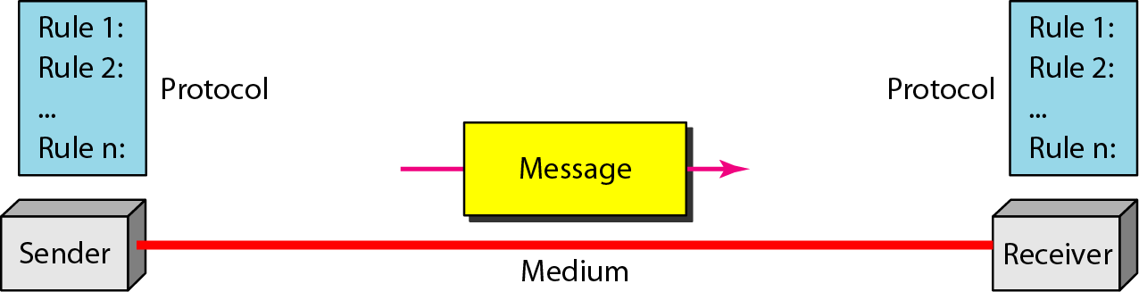
Components of Data Communication
1.Message, 2.Sender, 3.Receiver, 4.Medium and 5.Protocol
Source: Data Communications and Networking – Behrouz A. Forouzan
Notes:
The protocol defines a common set of rules and signals that computers on the network use to communicate. One of the most popular protocols for LANs is called Ethernet.
Message : It is the data to be communicated. It consists of text, numbers, pictures, sound, or video or any combination of these.
Sender : It is the device that sends the data message. It can be a computer, workstation, telephone handset, video camera.
Receiver : It is the device that receiver the message. It can be a computer, workstation, telephone, and television.
Medium : Transmission medium is the physical path by which a message travels from sender to receiver. Example it consists of twisted pair wire, co axial cable, fiber optical, laser or radio waves.
Protocol: It is a set of rules that govern data communication. Without a protocol two devices are connected but not communicated.

Slide 6
PROTOCOLS
A protocol is synonymous with rule. It consists of a set of rules that govern data communications. It determines what is communicated, how it is communicated and when it is communicated.
The key elements of a protocol are
syntax, semantics and timing

Slide 7
Elements of a Protocol
Syntax
Structure or format of the data
Indicates how to read the bits
Semantics
Interprets the meaning of the bits
Knows which fields define what action
Timing
When data should be sent and what
Speed at which data should be sent or speed at which it is being
received.

Slide 8

Networks
set of devices connected by communication links.
computer, printer, or any other device capable of sending and/or receiving data generated by other nodes on the network.
Network Criteria
Performance
Reliability
Security
Notes:
A network is a set of devices (often referred to as nodes)
connected by communication links. A node can be a
computer, printer, or any other device capable of sending
and/or receiving data generated by other nodes on the
network. A link can be a cable, air, optical fiber, or any
medium which can transport a signal carrying
information.
Performance
Depends on Network Elements
Measured in terms of Delay and Throughput
Reliability
Failure rate of network components
Measured in terms of availability/robustness
Security
Data protection against corruption/loss of data due to:
Errors
Malicious users

Slide 9
COMPONENTS OF COMPUTER NETWORK
Two or more computers
Cables as links between the computers
A network interfacing card(NIC) on each computer
Switches
Software called operating system(OS)

Slide 10
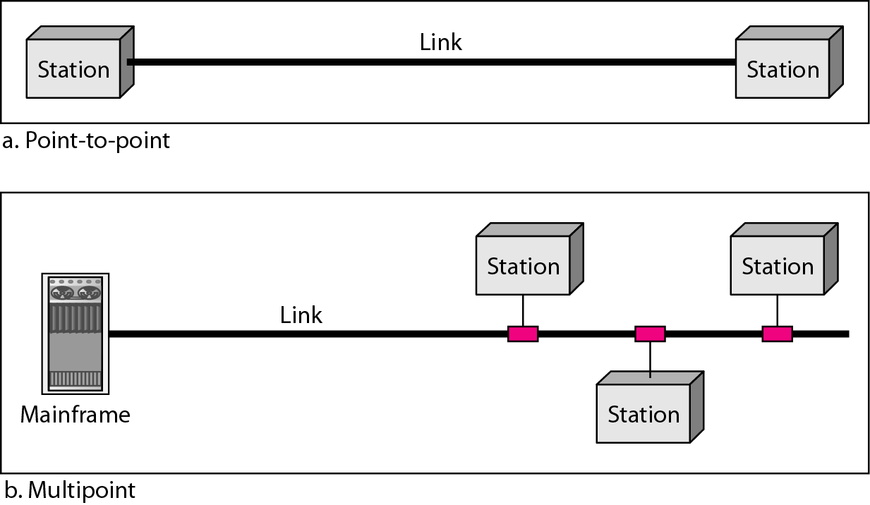
Line Configuration
Source: Data Communications and Networking – Behrouz A. Forouzan
Notes:
Physical Structures
Type of Connection
Point to Point - single transmitter and receiver
Multipoint - multiple recipients of single transmission
Physical Topology
Connection of devices
Type of transmission - unicast, mulitcast, broadcast

Slide 11
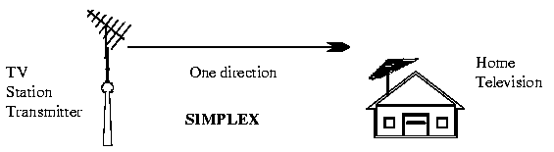
Data Flow
Simplex: Data flows in only one direction
E.g. Radio and Television broadcasts. They go from the TV station to your home television.

Slide 12

Data flow -Continued
Half duplex: Data flows in both directions but only one direction at a time on the data communication line.
Ex. Conversation on walkie-talkies

Slide 13

Data flow -Continued
Full duplex: Data flows in both directions simultaneously at the same time.
Ex. Phone communication

Slide 14
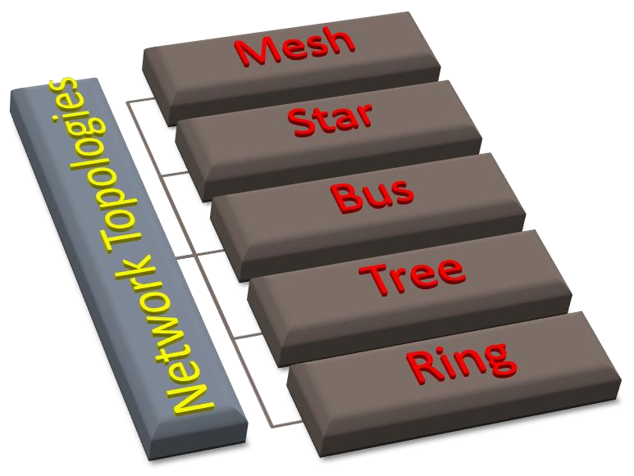
Network Topology
Physical layout of a network
The geometric representation of the relationship of all the links and linking devices (nodes) to one another.
Mesh
Star
Bus
Tree
Ring

Slide 15
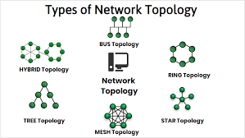
Types of Network Topology
Notes:
The arrangement of a network which comprises of nodes and connecting lines via sender and receiver is referred as network topology. The various network topologies are
a) Mesh Topology :
In mesh topology, every device is connected to another device via particular channe

Slide 16
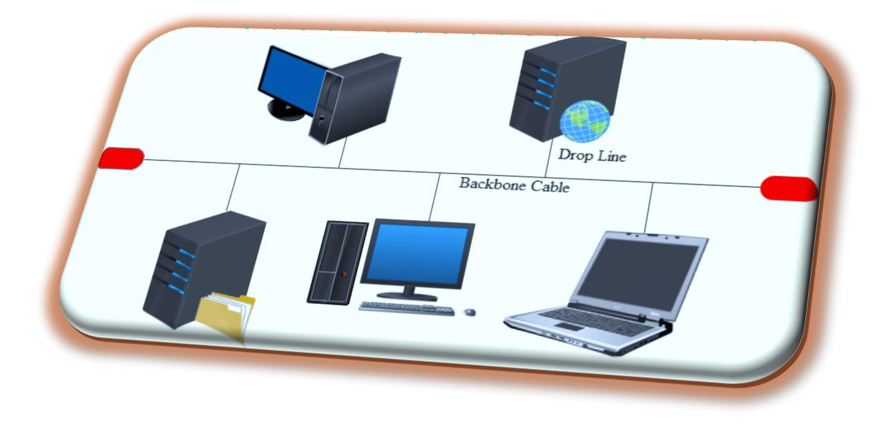
Bus Topology
All stations are attach directly to a linear transmission medium through
appropriate hardware interfacing known as a tap.
Backbone Cable
Data Flow - Full duplex
Terminator
Advantages
Ease of installation
Less cabling
Disadvantages
Difficult reconfiguration and fault isolation
Difficult to add new devices
If backbone cable fails, it can stops all transmission.

Slide 17
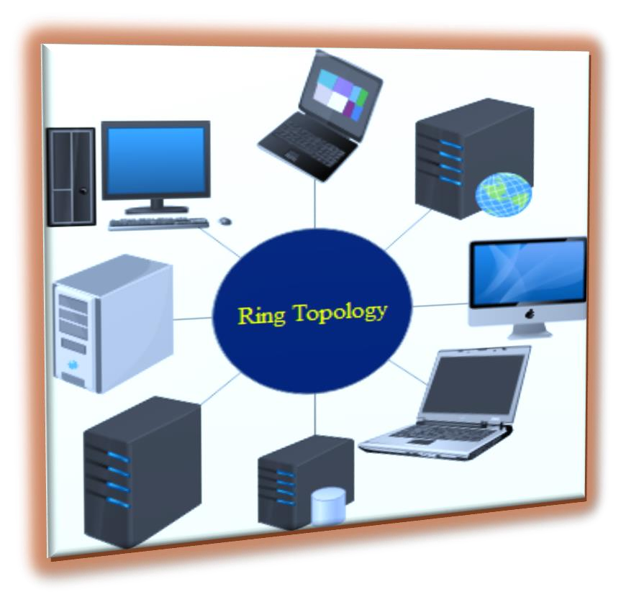
Ring Topology
Repeaters
Point-to-point links
Closed loop
Uni-directional Link
Advantages
Easy to install and reconfigure
Easy fault identificatio
Disadvantages
Unidirectional traffic
Network fails even if single link break exists

Slide 18
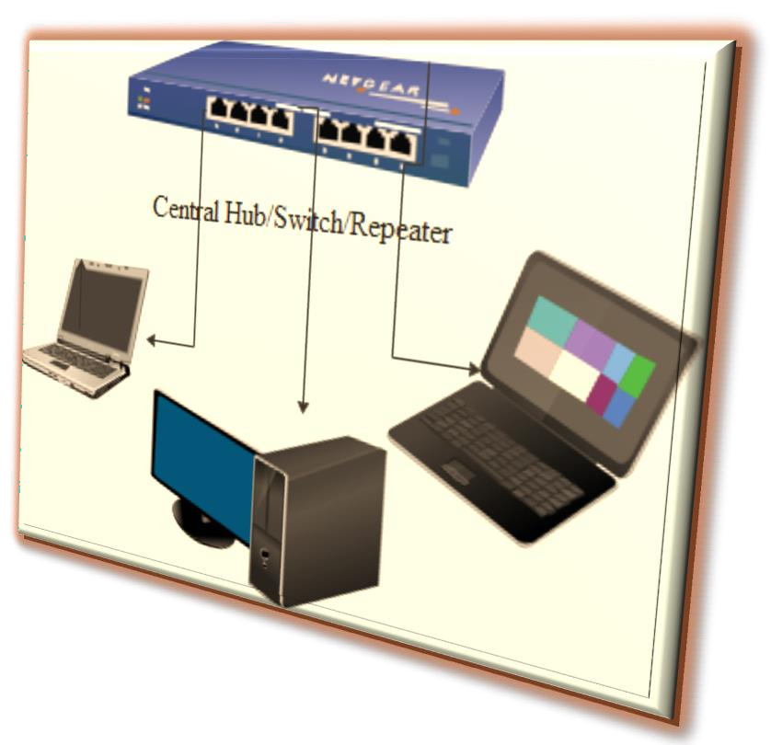
Star Topology
Central Controller
Two point to point links – Transmission/Reception
Broadcasting device
Frame switching device
Advantages
Less expensive and less cabling
Installation and configuration are easy
Robust and Easy fault identification
No disruptions
Disadvantages
Large Topology
Dependency

Slide 19
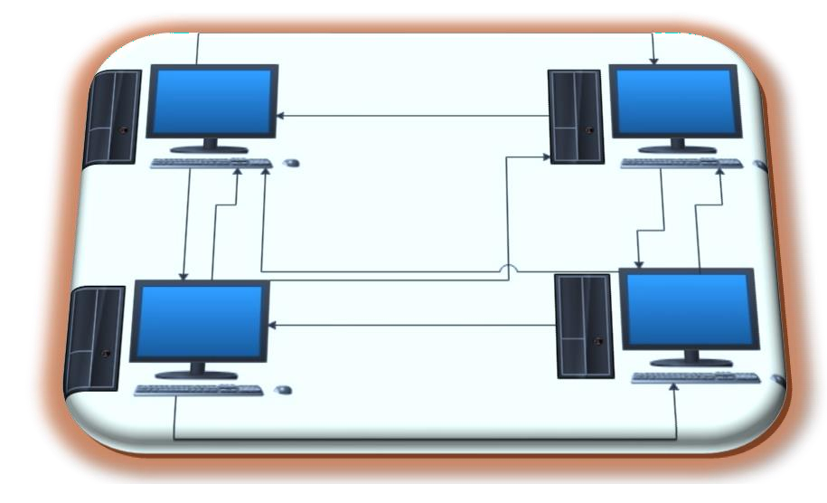
Mesh Topology
Every device has a dedicated point-to-point link to every other device
n(n-1)/2 physical channels to link n devices.
n-1 I/O ports.
Advantages
No traffic issues
Robust
Privacy and security.
Easy Fault identification and fault isolation
Disadvantages
Requires more number of cables and I/O ports
Wiring occupies more space
Hardware expensive

Slide 20
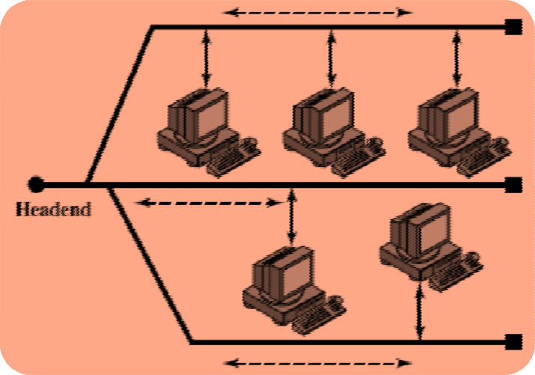
Tree Topology
Alternatively referred to as a star bus topology.
Tree topology is one of the most common network setups that is similar to a bus topology and a star topology.
A tree topology connects multiple star networks to other star networks. Below is a visual example of a simple computer setup on a network using the star topology.

Slide 21
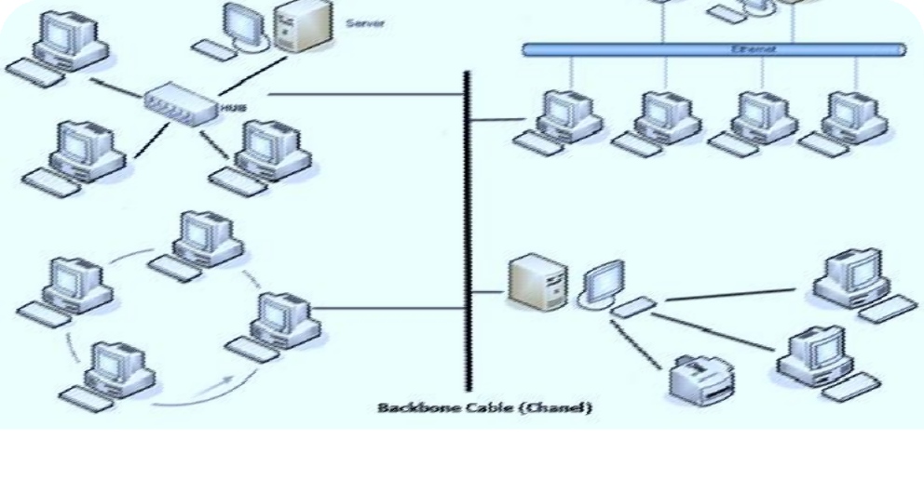

Hybrid Topology
A network which contain all type of physical structure and connected under a single backbone channel.

Slide 22
Applications of Network Topology
Mesh Topology
Telephone Regional office.
Wide Area Network – WAN
Star Topology
Star topology used in Local Area Networks(LANs).
High speed LAN often uses STAR.
Bus Topology
Most computer motherboard.
Ring Topology
Ring topologies are found in some office buildings or school
campuses.
Today high speed LANs made this topology less popular

Slide 23
Considerations for choosing topology
Money
Bus n/w may be the least expensive way to install a n/w.
Length-of cable needed
The linear bus n/w uses shorter lengths of cable.
Future growth
With star topology, expending a n/w is easily done by adding another devices.
Cable type
Most common used cable in commercial organization is twisted pair. which often used with star topologies.

Slide 24
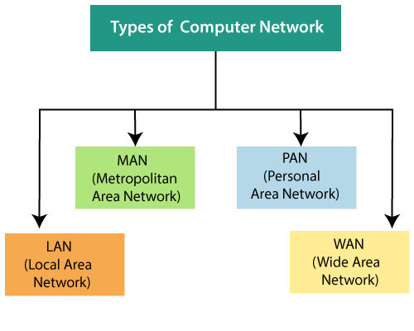
Network Categories
Notes:
Classification of Computer Networks
Computer networks are classified based on various factors.They includes:
Geographical span
Inter-connectivity
Administration
Architecture
Geographical Span
Geographically a network can be seen in one of the following categories:
It may be spanned across your table, among Bluetooth enabled devices,. Ranging not more than few meters.
It may be spanned across a whole building, including intermediate devices to connect all floors.
It may be spanned across a whole city.
It may be spanned across multiple cities or provinces.
It may be one network covering whole world.
Inter-Connectivity
Components of a network can be connected to each other differently in some fashion. By connectedness we mean either logically , physically , or both ways.
Every single device can be connected to every other device on network, making the network mesh.
All devices can be connected to a single medium but geographically disconnected, created bus like structure.
Each device is connected to its left and right peers only, creating linear structure.
All devices connected together with a single device, creating star like structure.
All devices connected arbitrarily using all previous ways to connect each other, resulting in a hybrid structure.
Administration
From an administrator’s point of view, a network can be private network which belongs a single autonomous system and cannot be accessed outside its physical or logical domain.A network can be public which is accessed by all.
Network Architecture
Computer networks can be discriminated into various types such as Client-Server,peer-to-peer or hybrid, depending upon its architecture.
There can be one or more systems acting as Server. Other being Client, requests the Server to serve requests.Server takes and processes request on behalf of Clients.
Two systems can be connected Point-to-Point, or in back-to-back fashion. They both reside at the same level and called peers.
There can be hybrid network which involves network architecture of both the above types.
Network Applications
Computer systems and peripherals are connected to form a network.They provide numerous advantages:
Resource sharing such as printers and storage devices
Exchange of information by means of e-Mails and FTP
Information sharing by using Web or Internet
Interaction with other users using dynamic web pages
IP phones
Video conferences
Parallel computing
Instant messaging

Slide 25
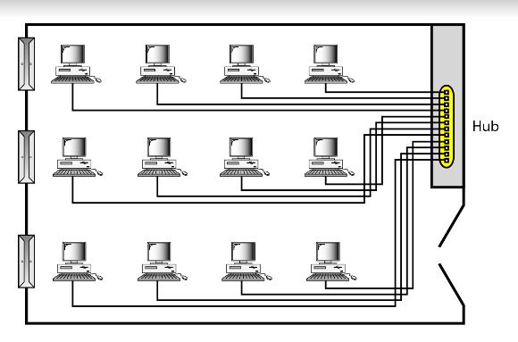
Local Area Network
Privately-owned networks within a single building or campus of up to a few kilometers in size.
The network can be categorized based on its size, its ownership, the distance it covers, and its physical architecture
LAN : 10m – Room, 100m - Building and 1km or 2 km – Campus.
An isolated LAN connecting 12 computers to a hub
Notes:
Network Hardware (Scale Perspective)
personal area networks (1m)
LAN: local area networks (10m ~ 1km)
MAN: metropolitan area networks (10km)
WAN: wide area network (100km ~ 1000km)
Internet

Slide 26
LAN
It covers a small geographical area with in a building or up to a few kilometers outside
They are widely used to connect PC with in a office.
LAN has distinguished from other networks by three characters.
size
their transmission technology
their Topology
LAN run at speeds of 10 Mbps to 100 Mbps. or (100/1000Mbps)
Different Topologies will be used for LAN Connectivity.
Bus / RING
IEEE 802.3 known as “Ethernet” - Example for LAN

Slide 27
Pros
LAN provides a cost-effective multi-user computer environment.
A LAN is suited to any type of application.
Any number of users can be accommodated.
It is flexible and growth-oriented.
Today speeds are normally 100 or 1000 Mbps.
It provide data integrity.

Slide 28
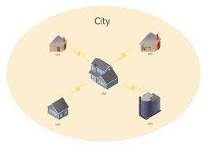
Metropolitan Area Network
A metropolitan area network, or MAN, covers a city. The best-known example of a MAN is the cable television network available in many cities.
Characteristics :Size, Transmission technology, Topology
Notes:
Computer networks can be classified into different types based on their scale of operation. They include:
LAN: A local-area network (LAN) is a computer network that spans a relatively small area. Most often, a LAN is confined to a single room, building or group of buildings, however, one LAN can be connected to other LANs over any distance via telephone lines and radio waves. Local Area Networks cover a small physical area, like a home, office, or a small group of buildings, such as a school or airport.
WAN: A computer network that spans a relatively large geographical area, generally having a radius of more than 1 km. . Typically, a WAN consists of two or more local-area networks (LANs). Computers connected to a wide-area network are often connected through public networks, such as the telephone system. They can also be connected through leased lines or satellites.
MAN: A metropolitan area network (MAN) is a network that interconnects users with computer resources in a geographic area or region larger than that covered by even a large local area network (LAN) but smaller than the area covered by a wide area network (WAN).
SAN: SAN (storage area network) is a high-speed network of storage devices that also connects those storage devices with servers. It provides block-level storage that can be accessed by the applications running on any networked servers. Storage Area Networks help attach remote computer storage devices, such as disk arrays, tape libraries, and optical jukeboxes, to servers in such a manner that that they appear to be locally attached to the operating system.
CAN: A Controller Area Network (CAN bus) is a vehicle bus standard designed to allow microcontrollers and devices to communicate with each other in applications without a host computer.
PAN: A personal area network (PAN) is a computer network used for data transmission amongst devices such as computers, telephones, tablets, personal digital assistants, fax machines and printers, that are located close to a single user.
GAN: A global area network (GAN) is a network used for supporting mobile across an arbitrary number of wireless LANs, satellite coverage areas, etc.
INTERNETWORK: Internetworking is the practice of connecting a computer network with other networks through the use of gateways that provide a common method of routing information packets between the networks. The resulting system of interconnected networks are called an internetwork, or simply an internet.
Computer networks are an integral part of our lives. It is only because of networking that telephones, televisions, radios, and the Internet are at our fingertips.
02.

Slide 29
MAN
The high speed links between LANs within a MAN are made
possible by fiber-optic connectionMAN is a bigger network covers a group of nearby offices in a city up to 10 – 20 kilometers range.
MAN supports both voice and data.
The typical example is Local Cable Network.
MAN run at speeds of 150 Mbps.
Bus Topology is used for MAN Connectivity.
The high speed links between LANs within a MAN are made
possible by fiber-optic connection
It may be a single network such as a cable TV network or it may be a means of connecting a number of LANs into a large network so that resources may be shared LAN-to-LAN as well as device-to- device.

Slide 30
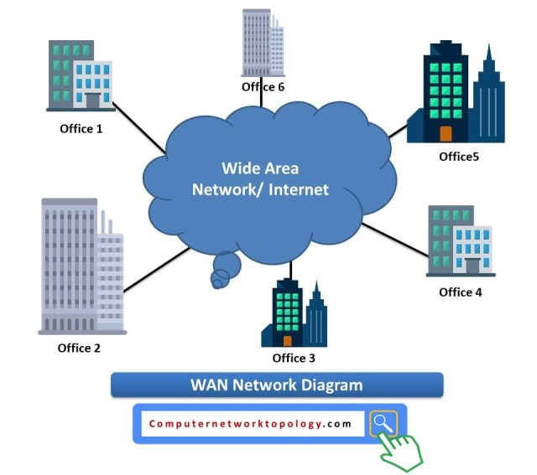
Wide Area Network
A wide area network, or WAN, spans a large geographical area, often a country or continent. It contains a collection of machines intended for running user (i.e., application) programs
Characteristics :Size, Transmission technology, Topology
100km – upto Country level , 1000km – upto continent and
10,000km – upto Planet level.( The Internet).

Slide 31
Wide Area Network
WAN covers a large geographical area , country or continent.
Hosts / Subnet - The job of the Subnet is to carry the messages from host to host.
Transmission Lines
Switching Elements ( Specialized Systems )
Packet Switched Nodes / Router
Inside the Subnet routers have a connectivity among themselves.
Store and Forward Concept
All the Topologies are applicable
Works at 100 Mbps to 1000 Mbps.

Slide 32
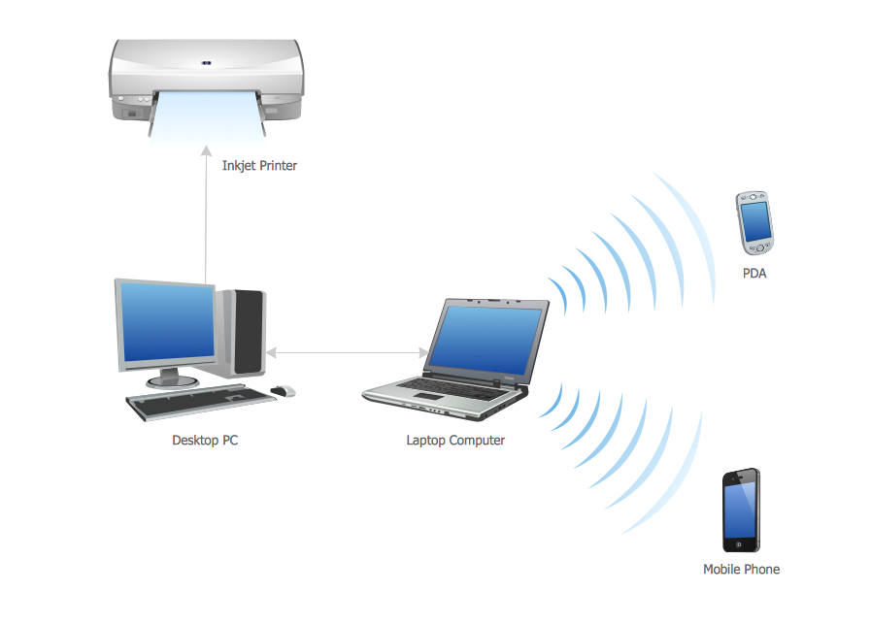
Personal Area Network
A personal area network, or PAN, is a computer network that enables communication between computer devices near a person.
Examples of wireless PAN, or WPAN, devices include cell phone headsets, wireless keyboards, wireless mice, printers, bar code scanners and game consoles

Slide 33
Characteristics of Network
Topology : The geometric arrangement of a computer system.
Protocol : The protocol defines a common set of rules and signals that computers on the network use to communicate. One of the most popular protocols for LANs is called Ethernet.
Architecture : Networks can be broadly classified as using either a peer to peer or client/server architecture.

Slide 34
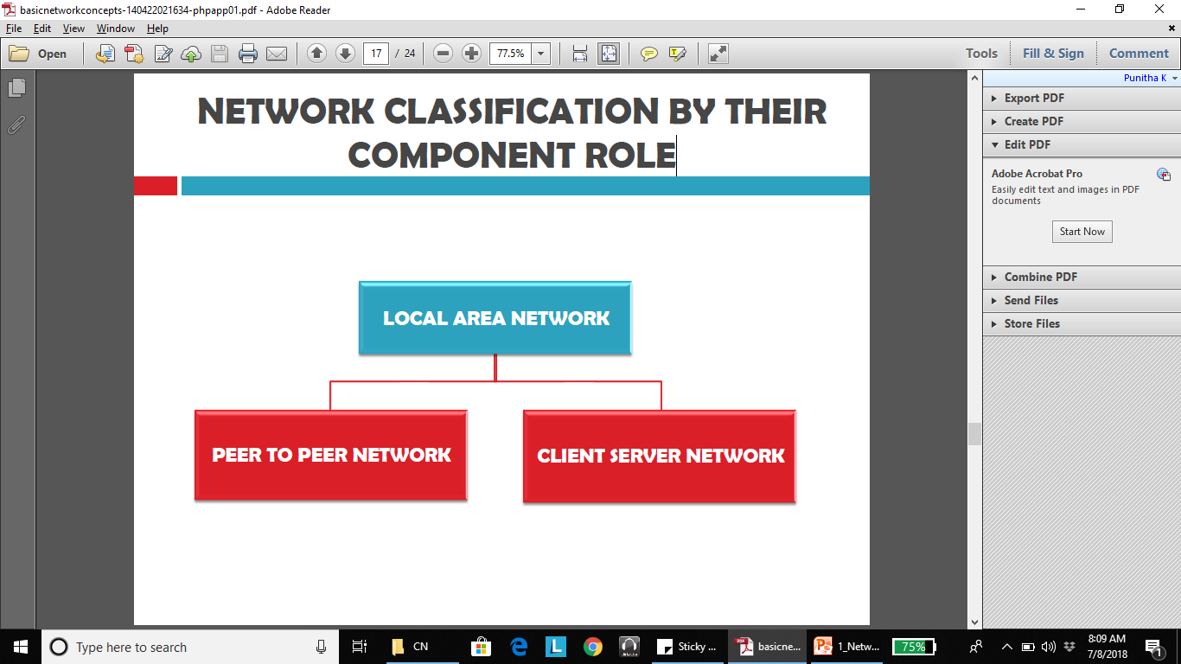
NETWORK CLASSIFICATION BY THEIR COMPONENT ROLE

Slide 35
PEER TO PEER NETWORK
In peer to peer network each computer is responsible for making its own resources available to other computers on the network.
Each computer is responsible for setting up and maintaining its own security for these resources.
Each computer is responsible for accessing the required network resources from peer to peer relationships.
This network is useful for a small network containing less than 10 computers on a single LAN. Each computer can function as both client and server and do not have a central control system.
There are no servers in peer network. Peer networks are amplified into home group.

Slide 36
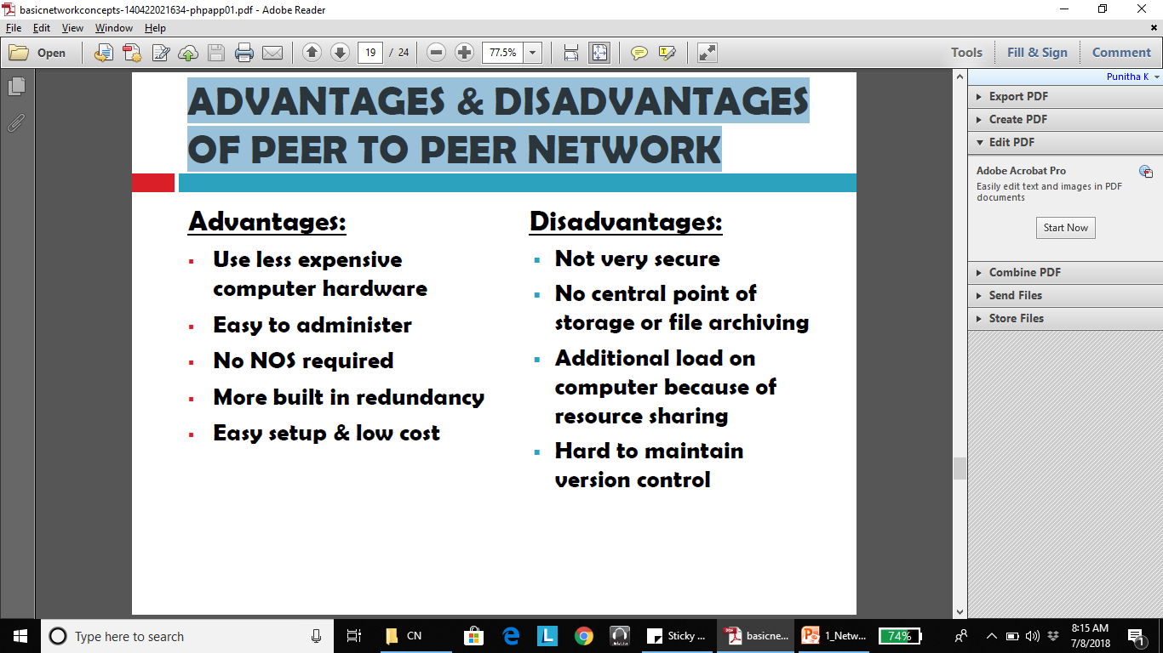
ADVANTAGES & DISADVANTAGES OF PEER TO PEER NETWORK
*NOS – Network Operating System

Slide 37
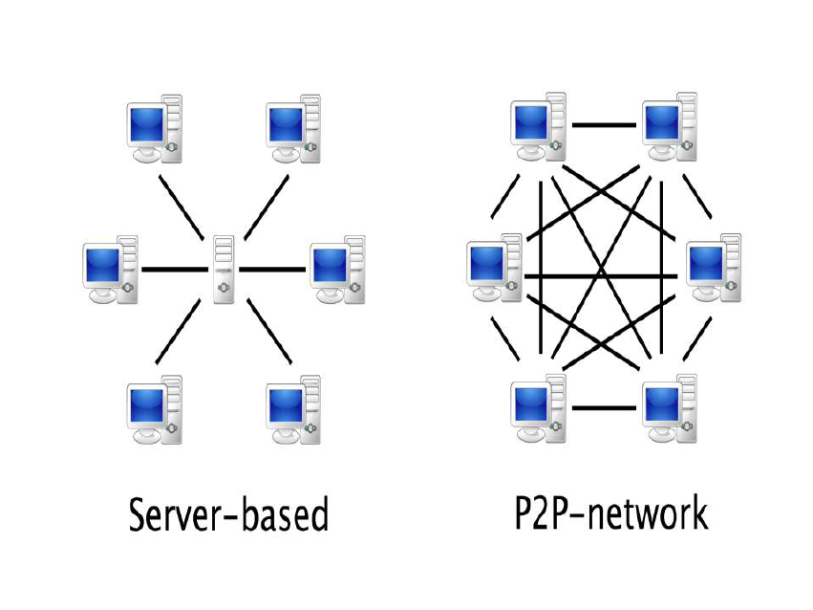

Slide 38
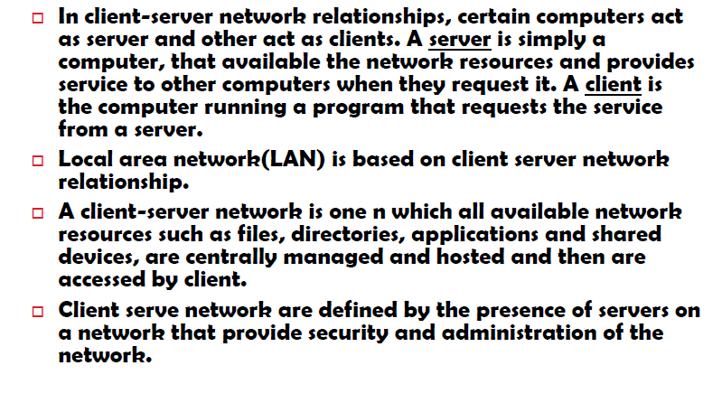

Slide 39
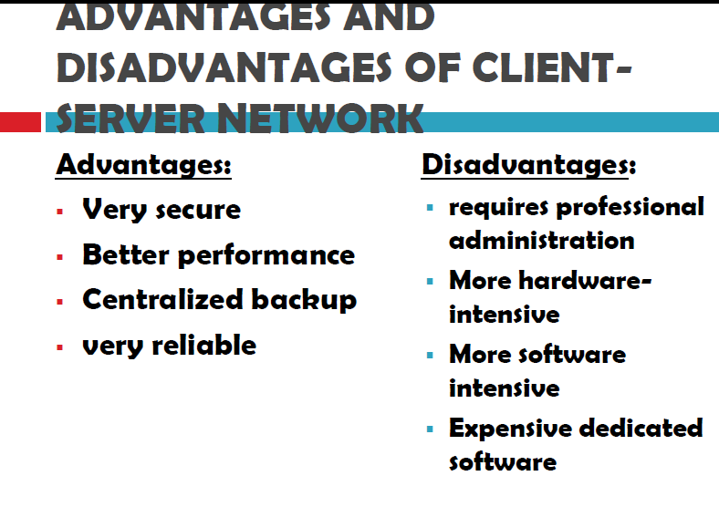

Slide 40
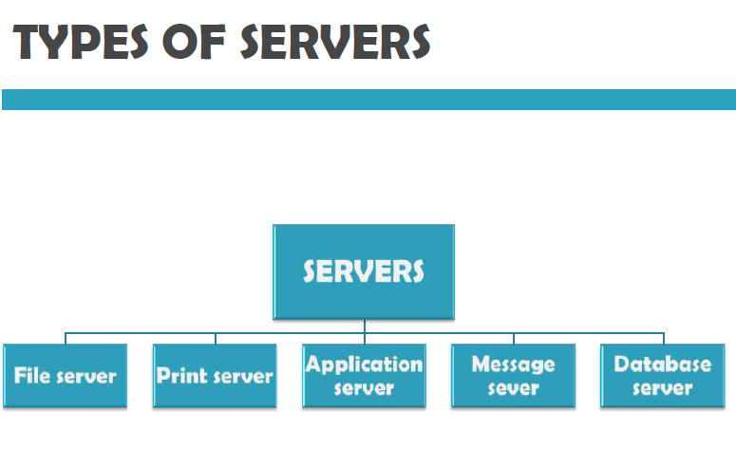

Slide 41
TYPES OF SERVERS
File server: provides services for storing, retrieving and moving data. User can read/write/exchange/manage files with help of file servers
Printer server: used for controlling and managing printing on the network. It also offers the fax service to the network users.
Application server: helps to share expensive software and additional computing power by the computers in a network.
Message server: used to co-ordinate the interaction between users, documents and applications. Data - audio,video,binary, text or graphics
Database server: It is a type of application server. It allows the uses to access the centralized strong database.

Slide 42
Network Benefits: SHARING RESOURCES
Types of resources are:
1. Hardware: A network allows users to share many hardware
devices such as printers, modems, fax machines, CD ROM, player, etc.
2. Software: sharing software resources reduces the cost of software installation, saves space on hard disk.

Slide 43
OTHER BENEFITS OF COMPUTER NETWORK
Increased speed
Reduced cost
Improved security
Centralized software managements
Electronic mail
Flexible access

Slide 44
Pros & Cons of Networks
Increased speed
Reduced cost
Improved security
Centralized software managements
Electronic mail
Flexible access
High cost of installation
Requires time for administration
Failure of server
Cable/Media faults

Slide 45
Applications of Networks:
Electronic messaging. (E-Mail)
Electronic data Interchange. ( E-Com.).
Teleconferencing.
Cellular Telephone.
Cable TV.
On-line Marketing , Sales, ticket reservations (boats, hotels, theaters)
Financial Services. (E- Cash).
Manufacturing.
Information Services.

Slide 46


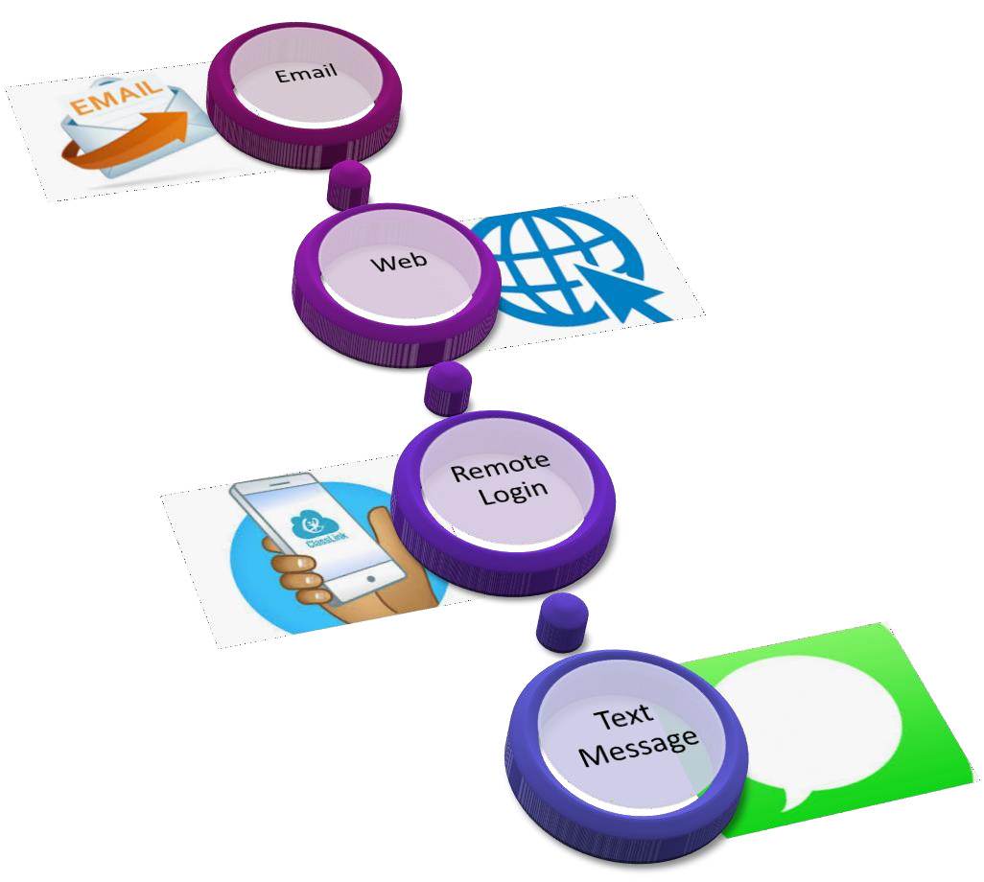
Applications of Networks

Slide 47
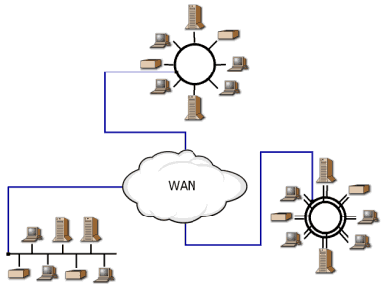
Internetwork
An Internetwork is a collection of independent remote networks, LANs and WANs, and their connecting devices. They function together as one large network sharing connectivity resources.
Internet : A global computer network providing a variety of information and communication facilities, consisting of interconnected networks using standardized communication protocols

Slide 48
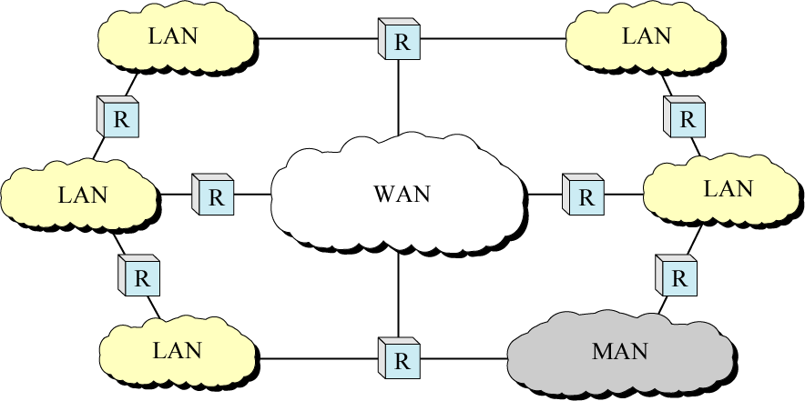
Internetwork (Internet)

Slide 49
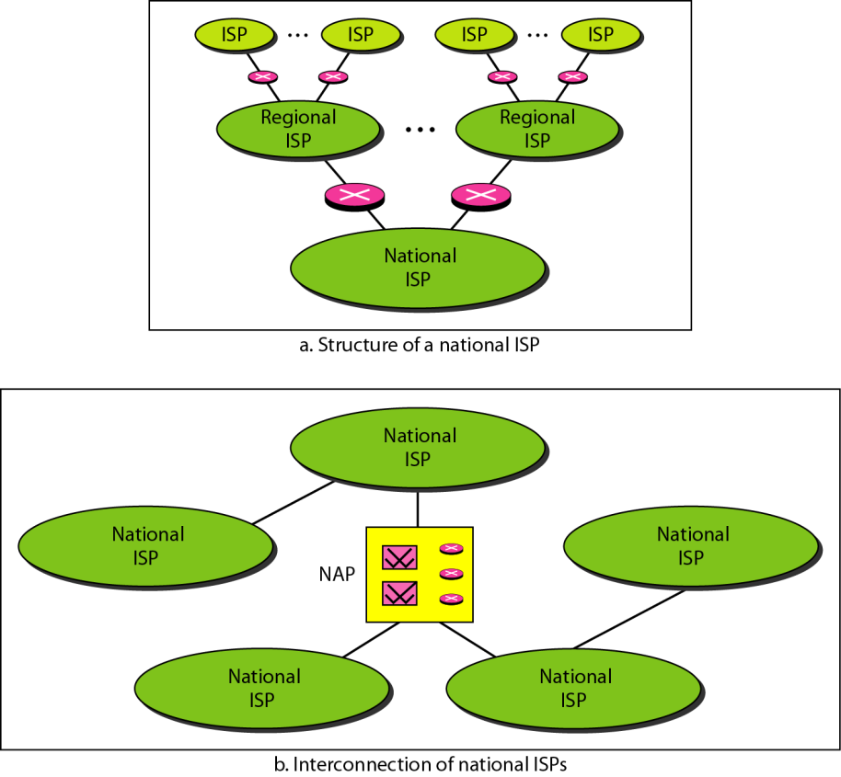
Hierarchical Organization of Internet
Notes:
An Internet Service Provider (ISP) is a company that provides Internet access by using copper, fiber, or even satellite communications to the customer.
Different types of ISP connections
ISPs use a range of technologies to enable customers' connection to their network. The most common types of internet connections include:
DSL (digital subscriber line)
cable broadband
fibre optic broadband
wireless or Wi-Fi broadband
satellite and mobile broadband
dedicated leased line

Slide 50
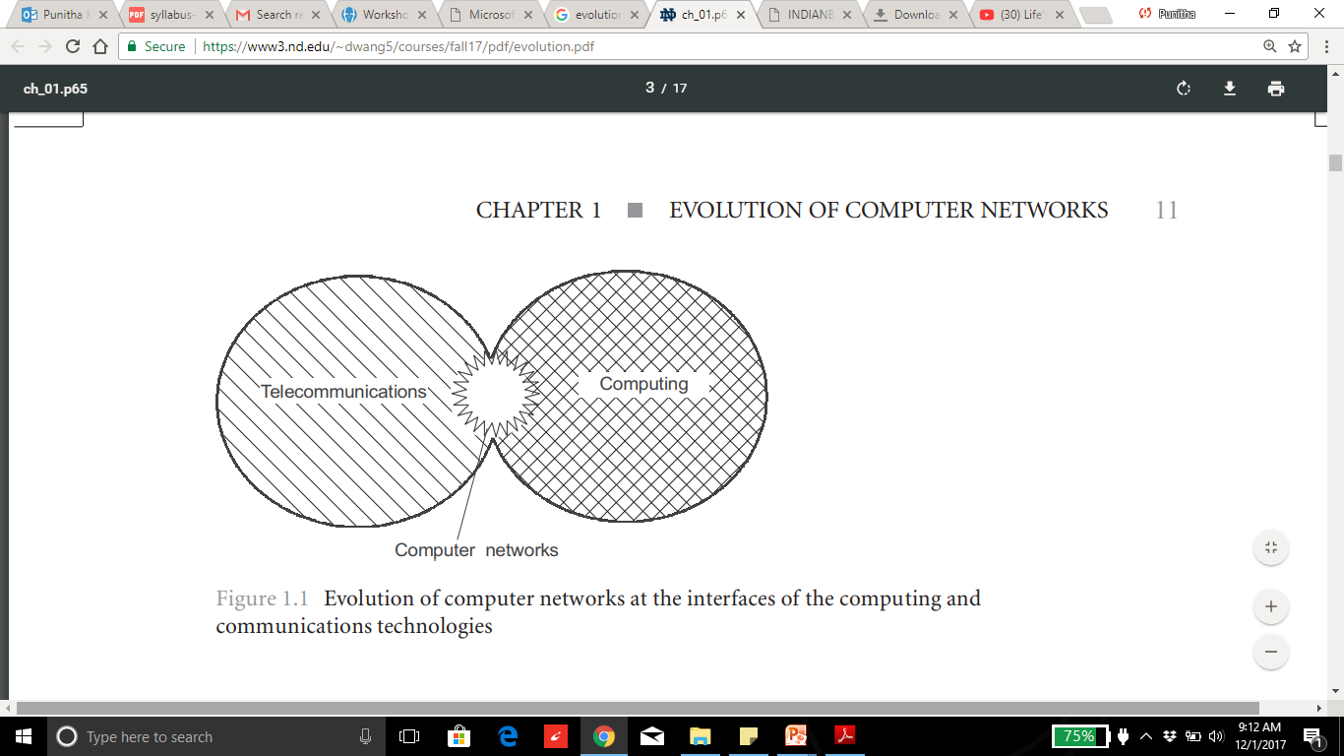
1. Evolution of network
Evolution of network

Slide 51
Evol….Roots of Computer networks
Computer networks: transmitting information over along distances. This implementation is done by various methods of data encoding and multiplexing in telecommunications systems.
Batch processing systems: 1950
Multiterminal systems: Prototype of the computer network(1960).

Slide 52
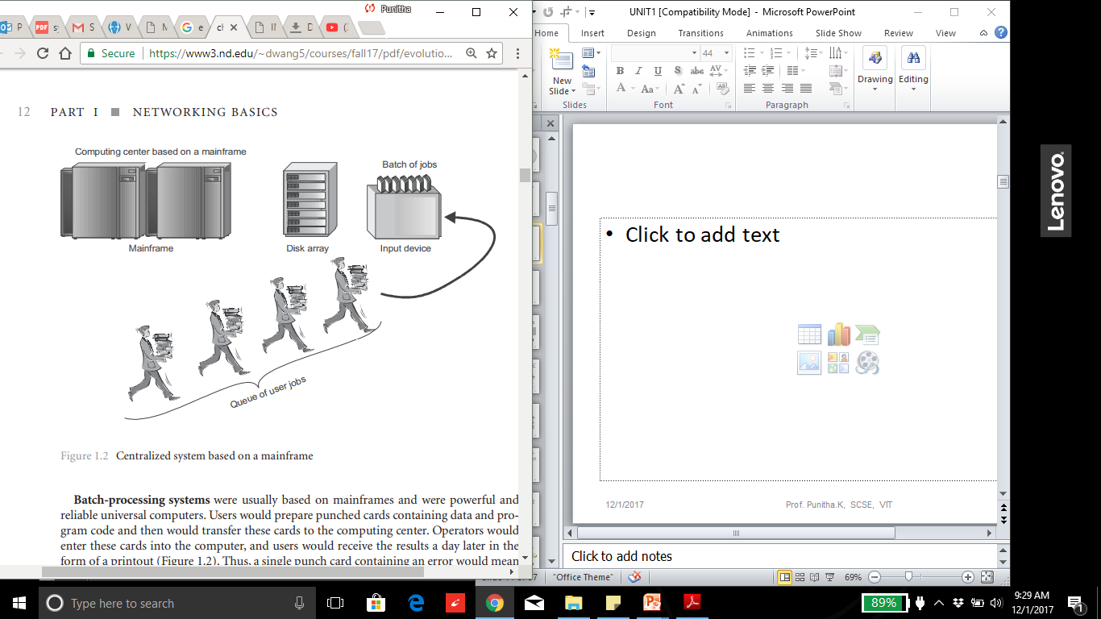
Batch processing systems

Slide 53
Disadvantage
Computer operators must be trained for using batch systems.
It is difficult to debug batch systems.
Batch systems are sometime costly.
If some job takes too much time i.e. if error occurs in job then other jobs will wait for unknown time

Slide 54
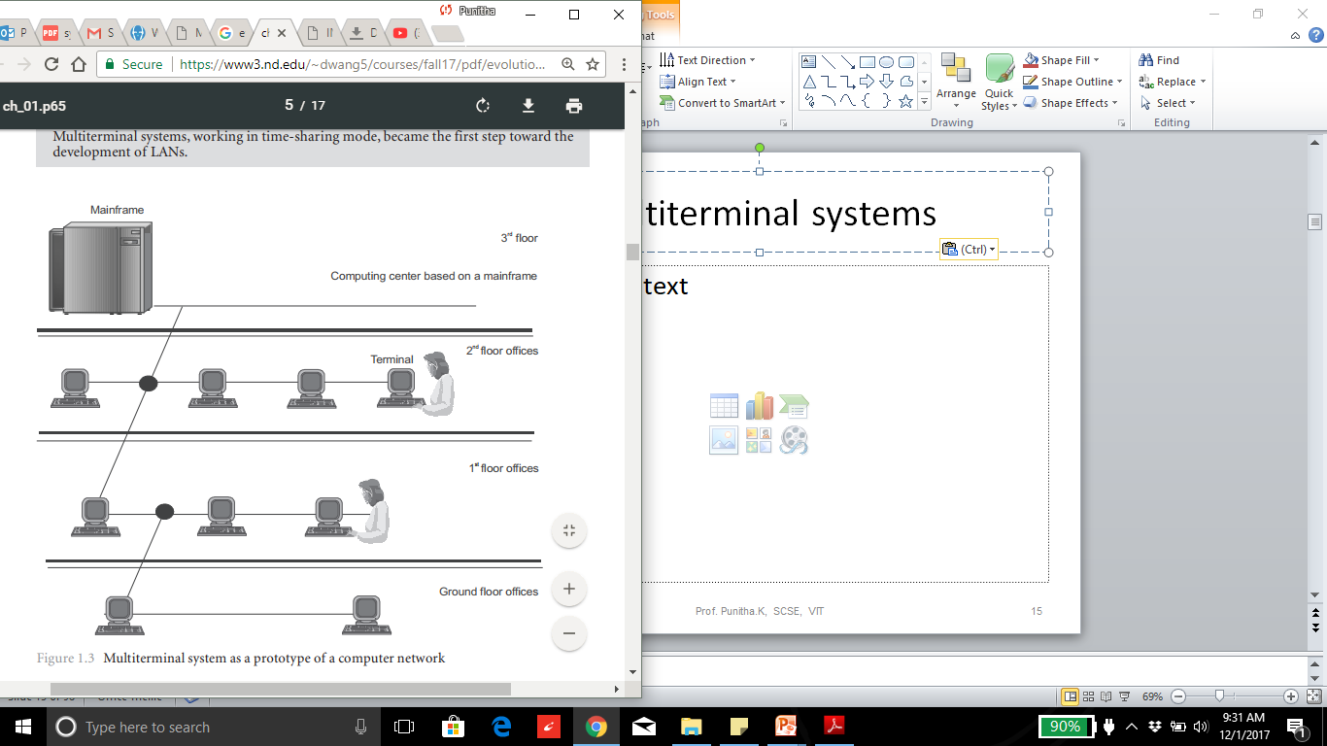
Multiterminal systems

Slide 55
Module_1_part 2

Slide 56
Outline
Protocols
Popular Protocols
Standards
List of Standard Organizations
OSI Model
TCP/IP Protocol

Slide 57
PROTOCOLS & STANDARDS

Slide 58
Protocols
Network Protocols
Set of rules that governs/used for communication. The key elements are given below.
1. Syntax: structure/format of the data. Meaning the order in which the data is present.
2. Semantics: The meaning of each section of bits.
3. Timing: Refers to two characteristics: - When data should be sent and how fast they can be sent.

Slide 59
How it works?
Network protocols take large-scale processes and break them down into small, specific tasks or functions.
Each layer is assigned a function.
This occurs at every level of the network and each function must cooperate at each level to complete the larger task at hand.

Slide 60
List of Network protocols
Communication
Network management
Security

Slide 61
Communication Protocol
Communication Protocol is a system of rules that allow two or more entities of a communications system to transmit information via any kind of variation of a physical quantity.

Slide 62
Simple Network Management Protocol: SNMP
An Internet Standard protocol for
collecting and organizing information about managed devices on IP networks
modifying that information to change device behavior.
Devices that typically support SNMP include cable modems, routers, switches, servers, workstations, printers, and more.

Slide 63
Network security protocols
Ensures the security and integrity of data in transit over a network connection.
Network security protocols define the processes and methodology to secure network data from any illegitimate attempt to review or extract the contents of data.

Slide 64
Popular Protocols
ISDN - Integrated Services Digital Network. Communication protocol offered by phone companies which allows phone networks to carry voice, video, and data.
CDMA - Code Division Multiple Access. X.25 - ITU’s standard that defines how connections between terminal equipment and computers are maintained.
TCP/IP (Transmission Control Protocol/Internet Protocol) suite
ARP (Address Resolution Protocol)
DNS (Domain Name System)
FTP (File Transfer Protocol)
HTTP (Hyper Text Transfer Protocol)
HTTPS (Hypertext Transfer Protocol Secure)
ICMP (Internet Control Message Protocol)
IGMP (Internet Group Management Protocol)
IMAP4 (Internet Message Access Protocol version 4)

Slide 65
Standards
Standard provides a model for development that makes it possible for a product to work regardless of the individual manufacturer
Dejure – haven’t approved by organized body, but adopted as standards through wide spread use ASCII USB
Defacto - Proprietary and Non proprietary
Proprietary – invented by commercial organizations; close off communications
Non proprietary-developed by groups or committees; open standards QWERTY

Slide 66
List of Standard Organizations
International Standard Organization (ISO). Responsible for a wide range of standards including networking standards.
CCITT - Consultative Committee for International Telegraph and Telephone. Responsible for development of Communication standards.
International Telecommunications Union-Telecommunications Standards Sector (ITU-T) - develops worldwide standards for telecommunication technologies.
American National Standard Institute (ANSI)
Institute of International Electrical and Electronics Engineers (IEEE)
Electronic Industries Association (EIA) .
Telecommunications Industry Association (TIA) and other leading telecommunication companies worked cooperatively to create ANSI/TIA/EIA-568-A standard for commercial buildings.

Slide 67
OSI MODEL

Slide 68
The OSI model
ISO is the organization. OSI is the model.
International Standards Organization (ISO) is a multinational body dedicated to worldwide agreement on international standards - Established in 1947.
An ISO standard that covers all aspects of network communications is the Open Systems Interconnection (OSI) model - introduced in the late 1970s.
The Open Systems Interconnection (OSI) model is a conceptual model created by the ISO which enables diverse communication systems to communicate using standard protocols.
Notes:
OSI (Open Systems Interconnection) is a reference model for how applications communicate over a network.
A reference model is a conceptual framework for understanding relationships. The purpose of the OSI reference model is to guide vendors and developers so the digital communication products and software programs they create can interoperate, and to facilitate a clear framework that describes the functions of a networking or telecommunication system.

Slide 69
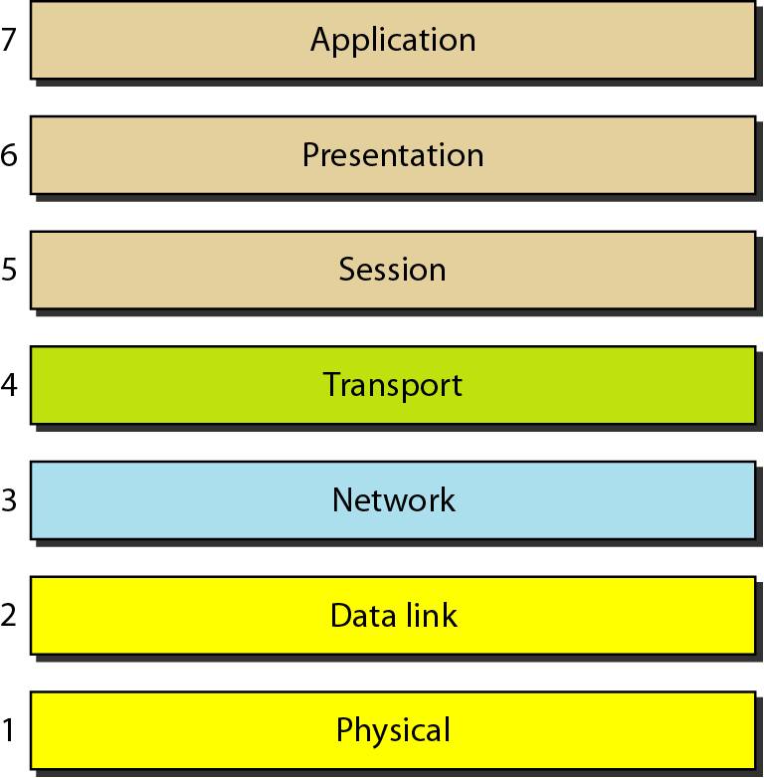
Seven layers of the OSI model
Source: Data Communications and Networking – Behrouz A. Forouzan

Slide 70
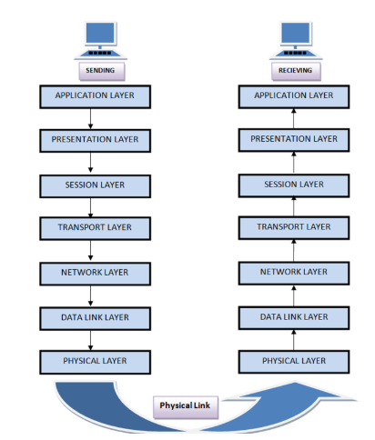

Slide 71
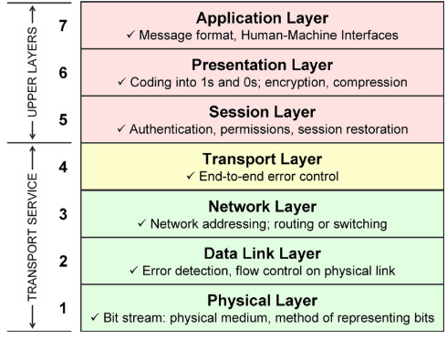

Slide 72
Functions of each layers
Layer 1—The physical layer:
This layer transmits bits from one computer to another and regulates the transmission of a stream of bits over a physical medium. This layer defines how the cable is attached to the network adapter and what transmission technique is used to send data over the cable.
Layer 2—The data-link layer:
This layer packages raw bits from the Physical layer into frames (logical, structures packets for data). It is responsible for transferring frames from one computer to another, without errors. After sending a frame, it waits for an acknowledgment from the receiving computer.
Layer 3—The network layer:
This layer handles the routing of the data, addresses messages and translates logical addresses and names into physical addresses. It also determines the route from the source to the destination computer and manages traffic problems (flow control), such as switching, routing, and controlling the congestion of data packets.
Layer 4—The transport layer:
This layer handles error recognition and recovery, manages the end-to-end control (for example, determining whether all packets have arrived) and error-checking. It ensures complete data transfer.

Slide 73
Functions of each layers
Layer 5—The session layer:
This layer allows applications on different computers to establish, use, and end a session/connection. This layer establishes dialog control between the two computers in a session, regulating which side transmits, and when and how long it transmits.
Layer 6—The presentation layer:
This is a layer, usually part of an operating system, that converts incoming and outgoing data from one presentation format to another (for example, from a text stream into a popup window with the newly arrived text). This layer also manages security issues by providing services such as data encryption and compression. It’s sometimes called the syntax layer.
Layer 7— The application layer:
This is the layer at which communication partners are identified, quality of service is identified, user authentication and privacy are considered, and any constraints on data syntax are identified. (This layer is not the application itself, although some applications may perform application layer functions). It represents the services that directly support applications such as software for file transfers, database access, email, and network games.

Slide 74
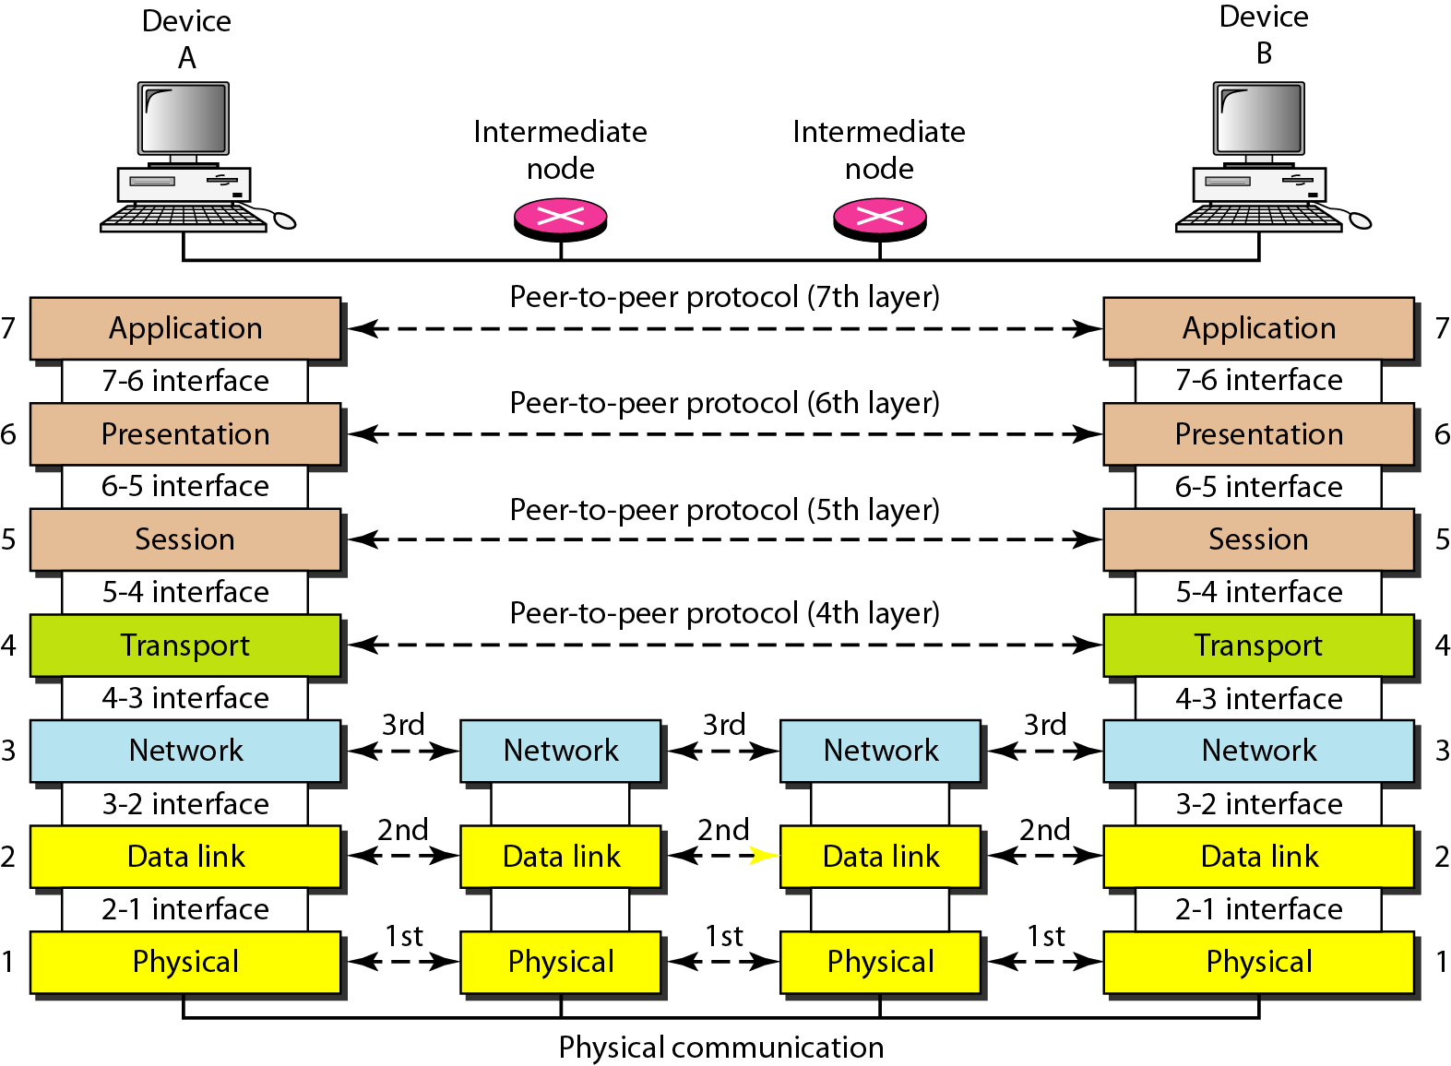
The interaction between layers in the OSI model
Source: Data Communications and Networking – Behrouz A. Forouzan

Slide 75
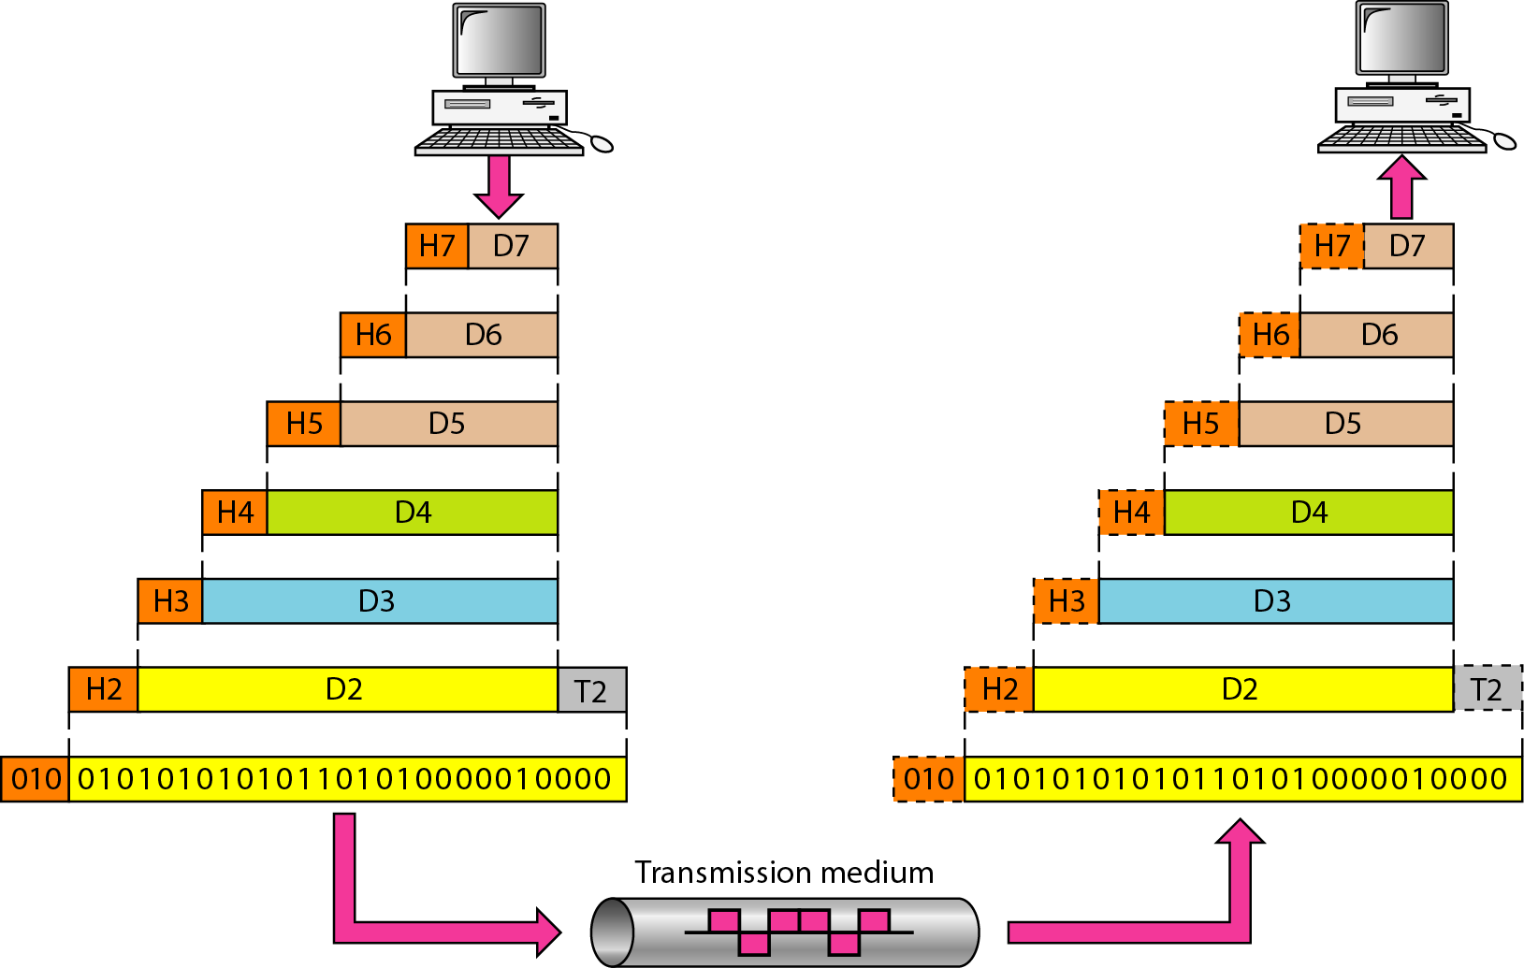
An exchange using the OSI model
Source: Data Communications and Networking – Behrouz A. Forouzan

Slide 76
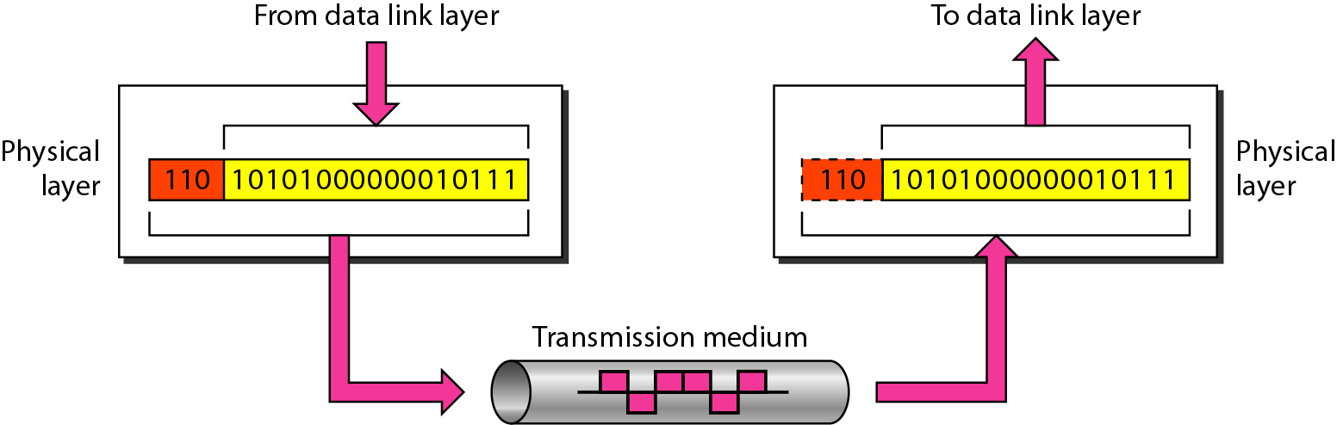
Physical layer
The physical layer is responsible for movements of
individual bits from one hop (node) to the next
Source: Data Communications and Networking – Behrouz A. Forouzan

Slide 77
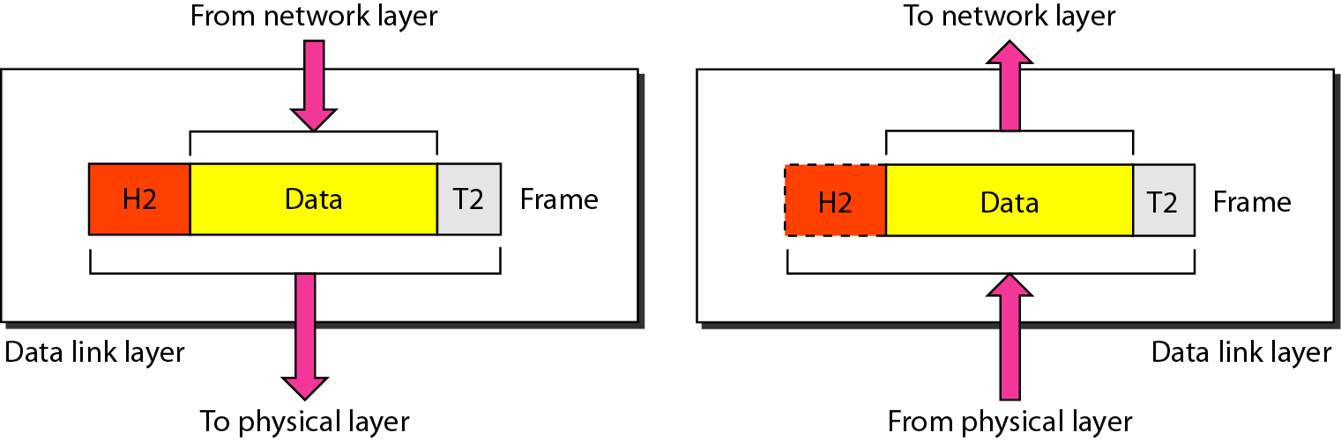
Data link layer (Cont....)
The data link layer is responsible for moving frames from one hop (node) to the next.
Source: Data Communications and Networking – Behrouz A. Forouzan

Slide 78
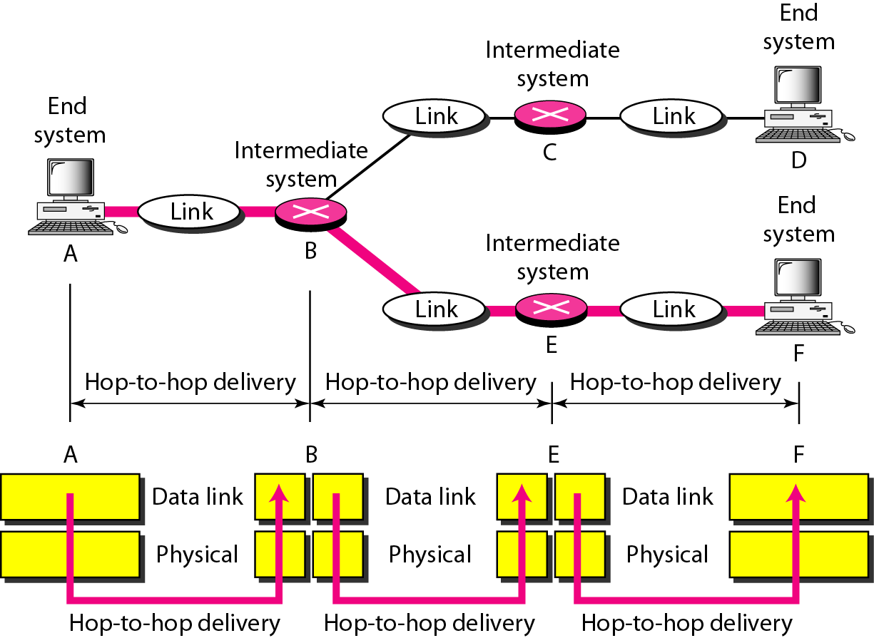
Hop-to-hop delivery
Source: Data Communications and Networking – Behrouz A. Forouzan

Slide 79
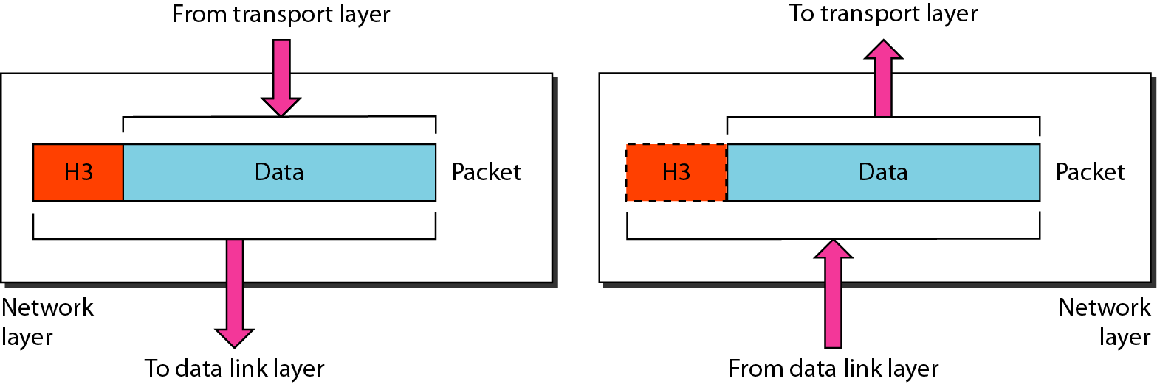
Network layer
The network layer is responsible for the delivery of individual packets from
the source host to the destination host.
Source: Data Communications and Networking – Behrouz A. Forouzan

Slide 80
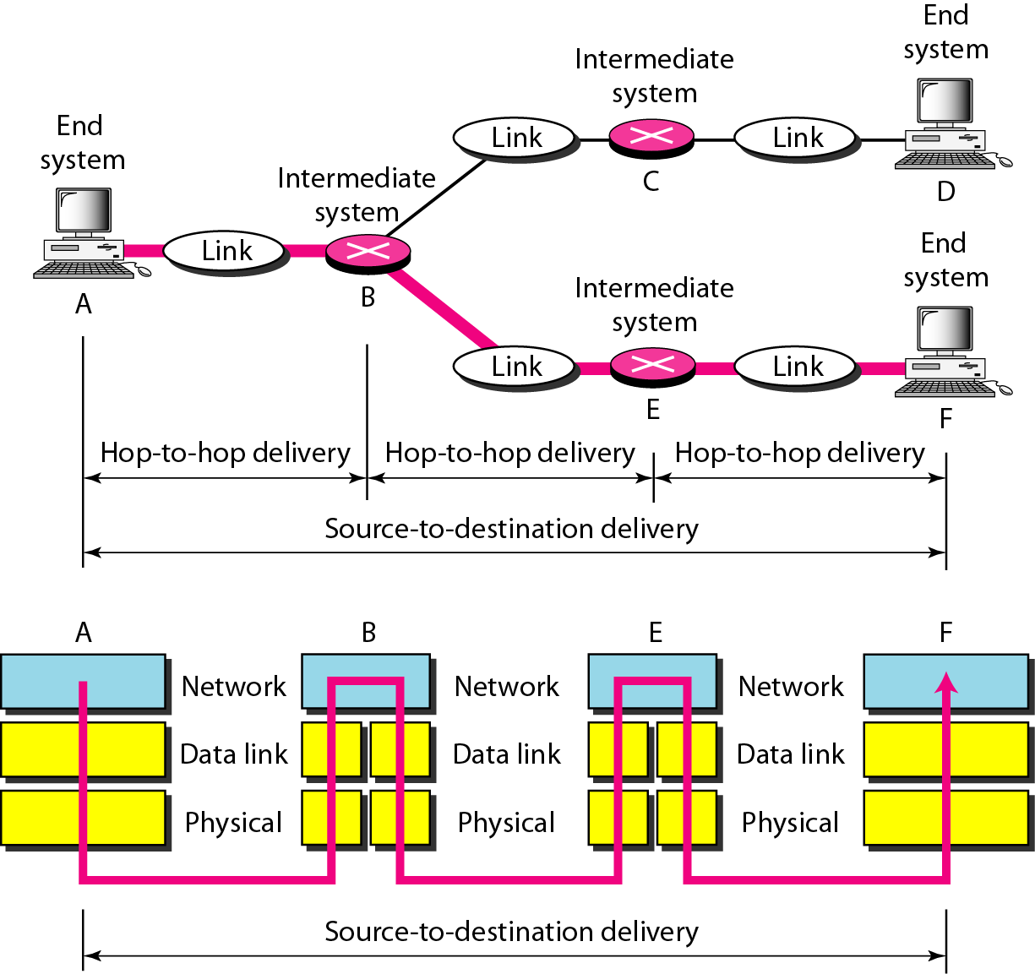
Source to destination delivery
Source: Data Communications and Networking – Behrouz A. Forouzan

Slide 81
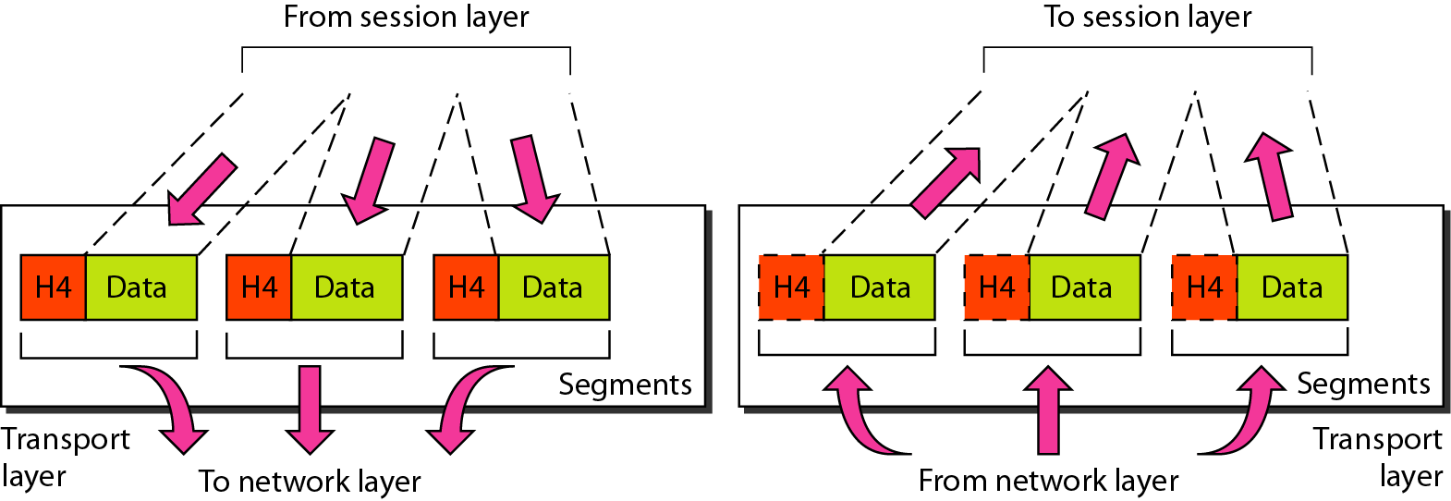
Transport layer
The transport layer is responsible for the delivery of a message from one process to another.
Source: Data Communications and Networking – Behrouz A. Forouzan

Slide 82
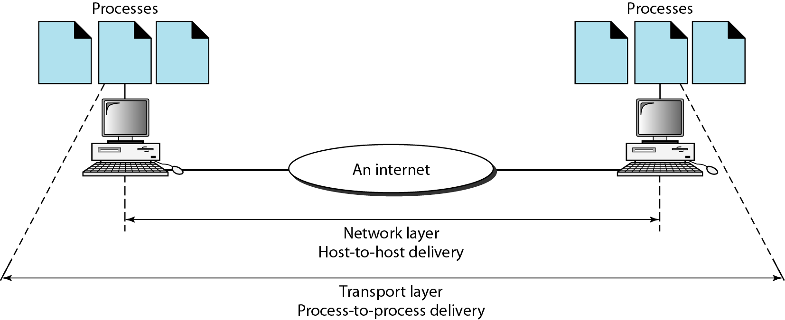
Reliable process-to-process delivery of a message
Source: Data Communications and Networking – Behrouz A. Forouzan

Slide 83
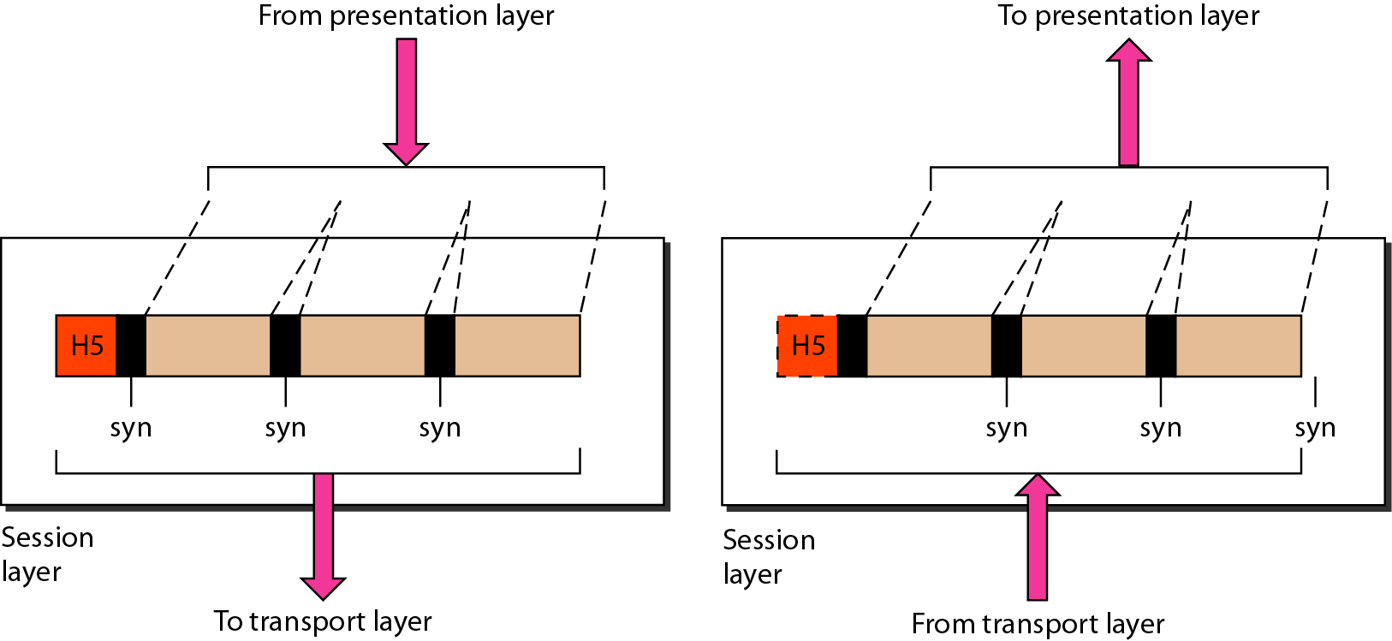
Session layer
The session layer is responsible for dialog control and synchronization.
Source: Data Communications and Networking – Behrouz A. Forouzan

Slide 84
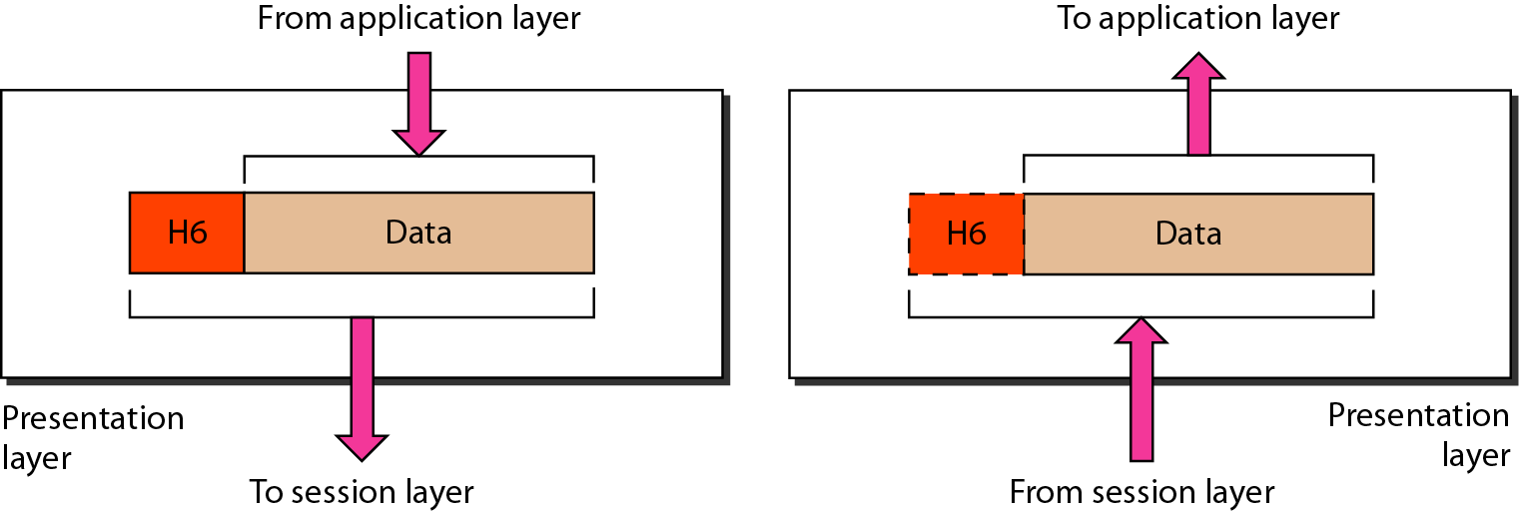
Presentation layer
The presentation layer is responsible for translation, compression, and encryption.
Source: Data Communications and Networking – Behrouz A. Forouzan

Slide 85
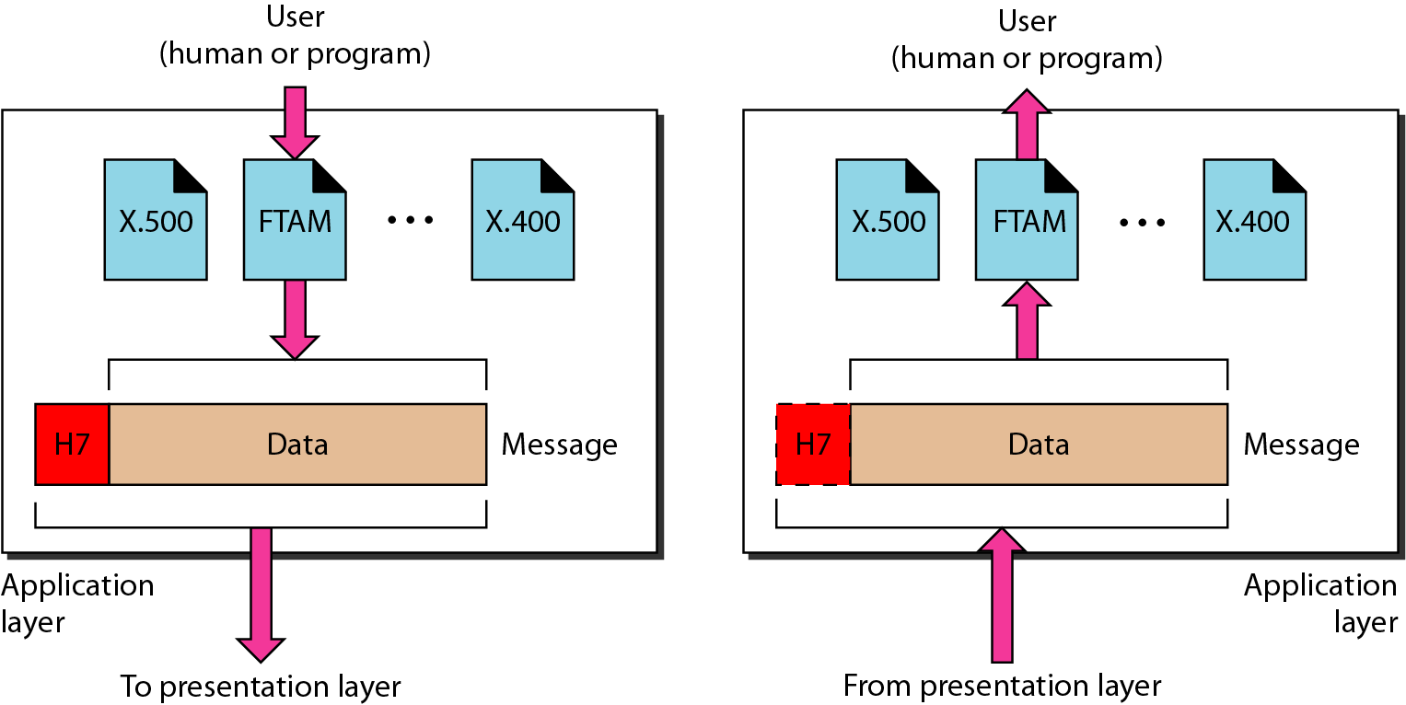
Application layer
The application layer is responsible for providing services to the user.
Source: Data Communications and Networking – Behrouz A. Forouzan

Slide 86
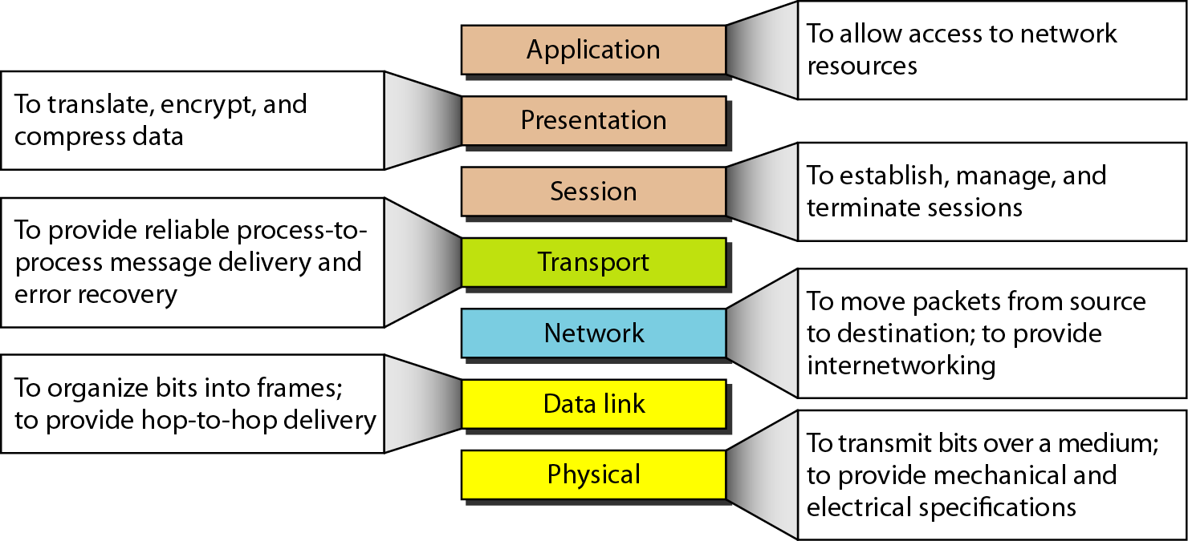
Summary of layers
Source: Data Communications and Networking – Behrouz A. Forouzan

Slide 87
TCP/IP PROTOCOL
DATA COMMUNICATION AND NETWORKING

Slide 88
TCP/IP PROTOCOL SUITE
The TCP/IP is compared to OSI, we can say that the TCP/IP protocol suite is made of five layers: physical, data link, network, transport, and application.
Topics discussed in this section:
Physical Layer
Data Link Layer
Network Layer
Transport Layer
Application Layer

Slide 89
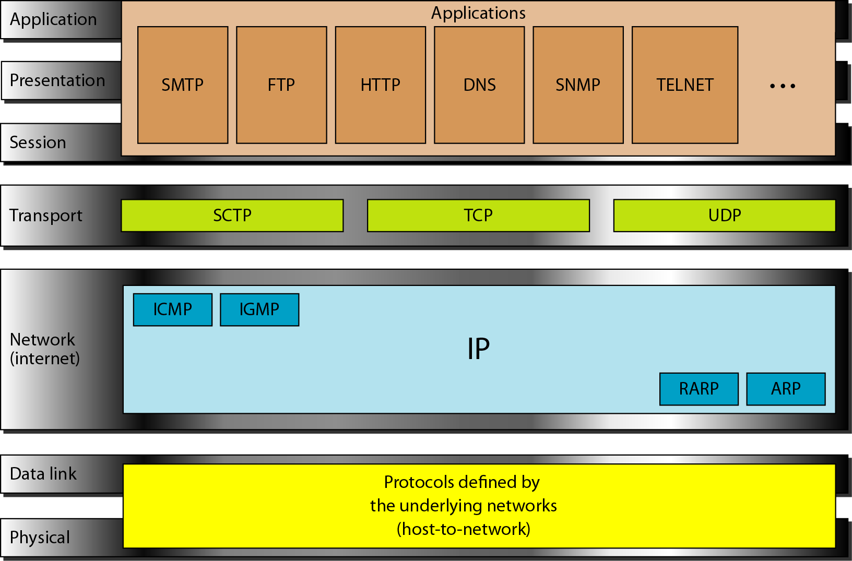
TCP/IP and OSI model
Source: Data Communications and Networking – Behrouz A. Forouzan

Slide 90
Addressing
Four levels of addresses are used in an internet employing the TCP/IP protocols
Physical Addresses
Addresses
Logical Addresses
Port Addresses
Specific Addresses

Slide 91
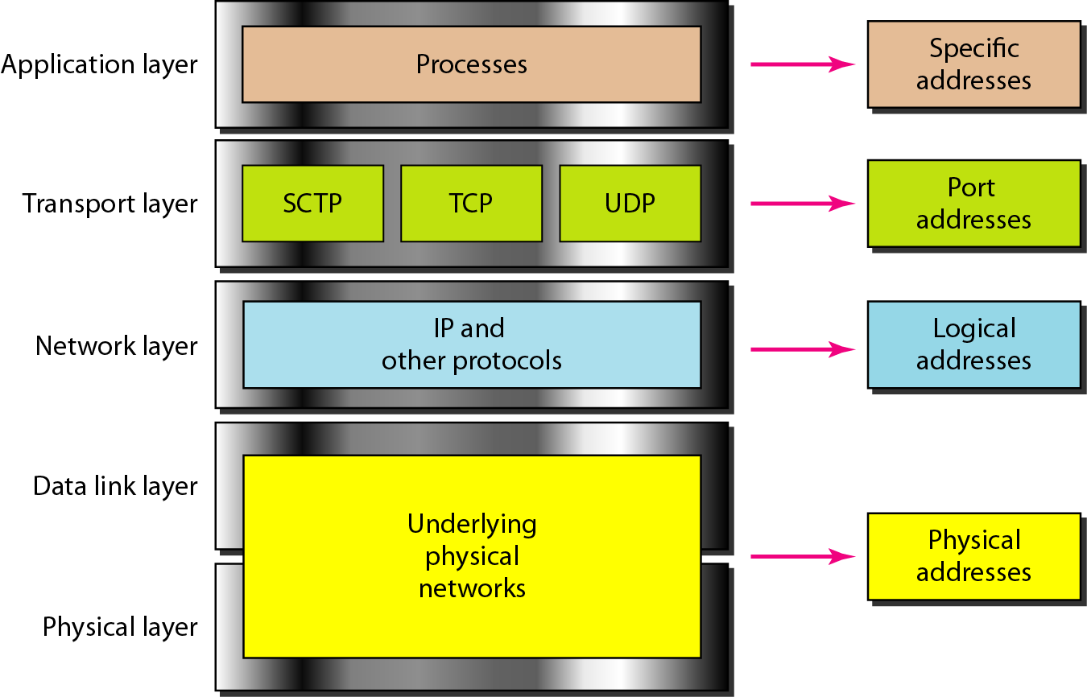
Relationship of layers and address TCP/IP
Source: Data Communications and Networking – Behrouz A. Forouzan

Slide 92
MAC address or Physical address
Most local-area networks use a 48-bit (6-byte) physical address written as 12 hexadecimal digits; every byte (2 hexadecimal digits) is separated by a colon, as shown below:
07:01:02:01:2C:4B
A 6-byte (12 hexadecimal digits) physical address
Source: Data Communications and Networking – Behrouz A. Forouzan

Slide 93
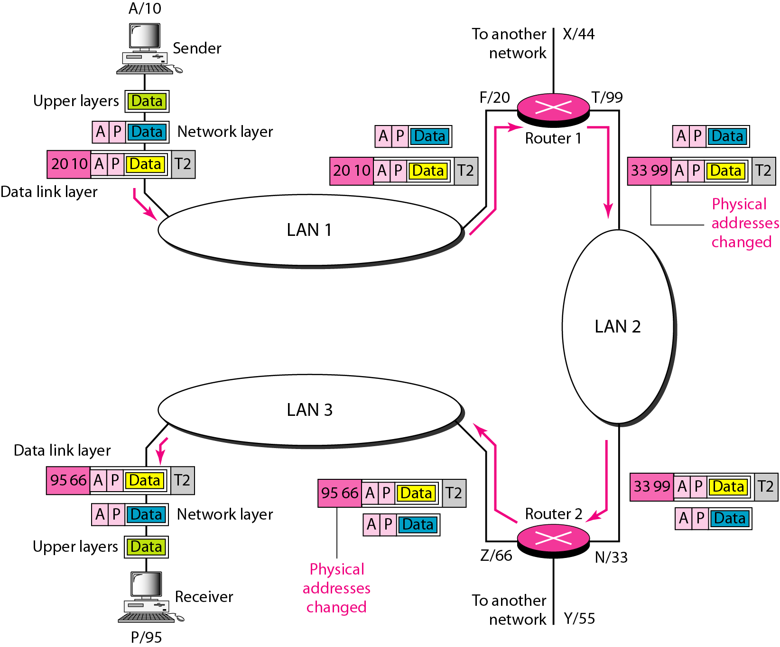
IP Address
The physical addresses will change from hop to hop,
but the logical addresses usually remain the same.
A logical address is a 32-bit(IPv4) or 128-bit(IPv6).
Examples
IPv4: 192.168.2.33 IPv6: 2dbe:ab67:237f:50cd:83fd:ab34:92bd:66ca
Source: Data Communications and Networking – Behrouz A. Forouzan

Slide 94
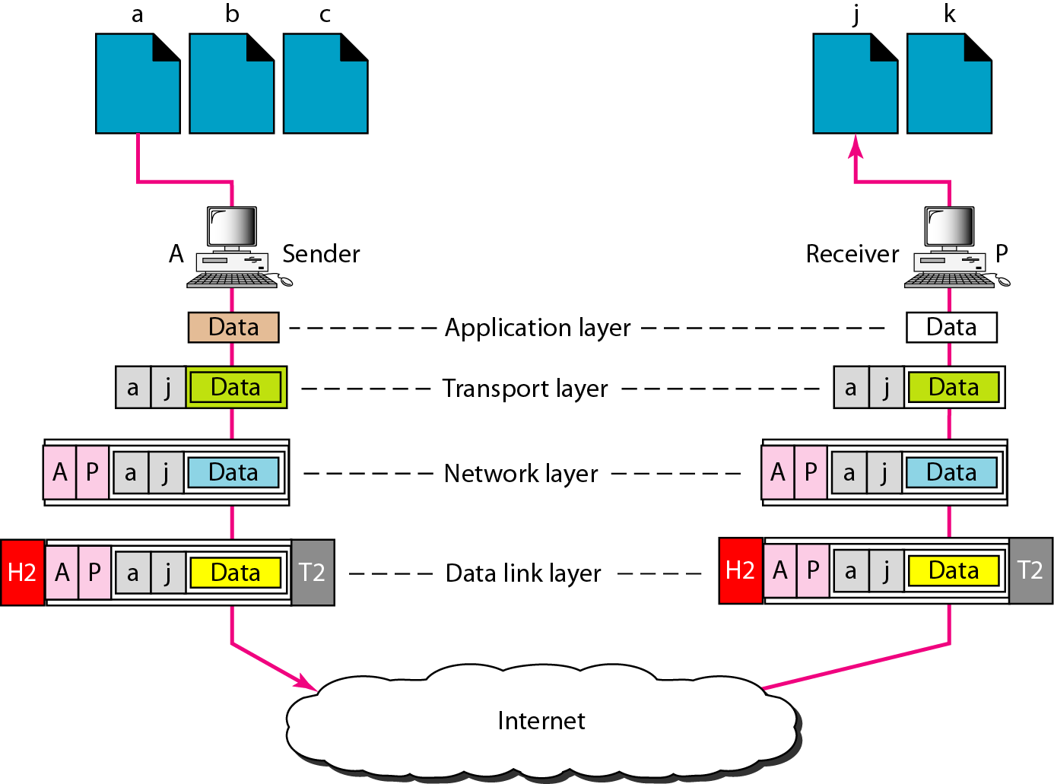
Port address
A port address is a 16-bit address represented by one decimal number. Ex.753
A 16-bit port address represented as single number.
Source: Data Communications and Networking – Behrouz A. Forouzan

Slide 95
Outline(Outline(module1_part 2)
Protocols
Popular Protocols
Standards
List of Standard Organizations
OSI Model
TCP/IP Protocol

Slide 96
PROTOCOLS & STANDARDS

Slide 97
Protocols
Network Protocols
Set of rules that governs/used for communication. The key elements are given below.
1. Syntax: structure/format of the data. Meaning the order in which the data is present.
2. Semantics: The meaning of each section of bits.
3. Timing: Refers to two characteristics: - When data should be sent and how fast they can be sent.

Slide 98
How it works?
Network protocols take large-scale processes and break them down into small, specific tasks or functions.
Each layer is assigned a function.
This occurs at every level of the network and each function must cooperate at each level to complete the larger task at hand.

Slide 99
List of Network protocols
Communication
Network management
Security

Slide 100
Communication Protocol
Communication Protocol is a system of rules that allow two or more entities of a communications system to transmit information via any kind of variation of a physical quantity.

Slide 101
Simple Network Management Protocol: SNMP
An Internet Standard protocol for
collecting and organizing information about managed devices on IP networks
modifying that information to change device behavior.
Devices that typically support SNMP include cable modems, routers, switches, servers, workstations, printers, and more.

Slide 102
Network security protocols
Ensures the security and integrity of data in transit over a network connection.
Network security protocols define the processes and methodology to secure network data from any illegitimate attempt to review or extract the contents of data.

Slide 103
Popular Protocols
ISDN - Integrated Services Digital Network. Communication protocol offered by phone companies which allows phone networks to carry voice, video, and data.
CDMA - Code Division Multiple Access. X.25 - ITU’s standard that defines how connections between terminal equipment and computers are maintained.
TCP/IP (Transmission Control Protocol/Internet Protocol) suite
ARP (Address Resolution Protocol)
DNS (Domain Name System)
FTP (File Transfer Protocol)
HTTP (Hyper Text Transfer Protocol)
HTTPS (Hypertext Transfer Protocol Secure)
ICMP (Internet Control Message Protocol)
IGMP (Internet Group Management Protocol)
IMAP4 (Internet Message Access Protocol version 4)

Slide 104
Standards
Standard provides a model for development that makes it possible for a product to work regardless of the individual manufacturer
Dejure – haven’t approved by organized body, but adopted as standards through wide spread use ASCII USB
Defacto - Proprietary and Non proprietary
Proprietary – invented by commercial organizations; close off communications
Non proprietary-developed by groups or committees; open standards QWERTY

Slide 105
List of Standard Organizations
International Standard Organization (ISO). Responsible for a wide range of standards including networking standards.
CCITT - Consultative Committee for International Telegraph and Telephone. Responsible for development of Communication standards.
International Telecommunications Union-Telecommunications Standards Sector (ITU-T) - develops worldwide standards for telecommunication technologies.
American National Standard Institute (ANSI)
Institute of International Electrical and Electronics Engineers (IEEE)
Electronic Industries Association (EIA) .
Telecommunications Industry Association (TIA) and other leading telecommunication companies worked cooperatively to create ANSI/TIA/EIA-568-A standard for commercial buildings.

Slide 106
OSI MODEL

Slide 107
The OSI model
ISO is the organization. OSI is the model.
International Standards Organization (ISO) is a multinational body dedicated to worldwide agreement on international standards - Established in 1947.
An ISO standard that covers all aspects of network communications is the Open Systems Interconnection (OSI) model - introduced in the late 1970s.
The Open Systems Interconnection (OSI) model is a conceptual model created by the ISO which enables diverse communication systems to communicate using standard protocols.
Notes:
OSI (Open Systems Interconnection) is a reference model for how applications communicate over a network.
A reference model is a conceptual framework for understanding relationships. The purpose of the OSI reference model is to guide vendors and developers so the digital communication products and software programs they create can interoperate, and to facilitate a clear framework that describes the functions of a networking or telecommunication system.

Slide 108
Seven layers of the OSI model
Source: Data Communications and Networking – Behrouz A. Forouzan

Slide 111
Functions of each layers
Layer 1—The physical layer:
This layer transmits bits from one computer to another and regulates the transmission of a stream of bits over a physical medium. This layer defines how the cable is attached to the network adapter and what transmission technique is used to send data over the cable.
Layer 2—The data-link layer:
This layer packages raw bits from the Physical layer into frames (logical, structures packets for data). It is responsible for transferring frames from one computer to another, without errors. After sending a frame, it waits for an acknowledgment from the receiving computer.
Layer 3—The network layer:
This layer handles the routing of the data, addresses messages and translates logical addresses and names into physical addresses. It also determines the route from the source to the destination computer and manages traffic problems (flow control), such as switching, routing, and controlling the congestion of data packets.
Layer 4—The transport layer:
This layer handles error recognition and recovery, manages the end-to-end control (for example, determining whether all packets have arrived) and error-checking. It ensures complete data transfer.

Slide 112
Functions of each layers
Layer 5—The session layer:
This layer allows applications on different computers to establish, use, and end a session/connection. This layer establishes dialog control between the two computers in a session, regulating which side transmits, and when and how long it transmits.
Layer 6—The presentation layer:
This is a layer, usually part of an operating system, that converts incoming and outgoing data from one presentation format to another (for example, from a text stream into a popup window with the newly arrived text). This layer also manages security issues by providing services such as data encryption and compression. It’s sometimes called the syntax layer.
Layer 7— The application layer:
This is the layer at which communication partners are identified, quality of service is identified, user authentication and privacy are considered, and any constraints on data syntax are identified. (This layer is not the application itself, although some applications may perform application layer functions). It represents the services that directly support applications such as software for file transfers, database access, email, and network games.

Slide 113
The interaction between layers in the OSI model
Source: Data Communications and Networking – Behrouz A. Forouzan

Slide 114
An exchange using the OSI model
Source: Data Communications and Networking – Behrouz A. Forouzan

Slide 115
Physical layer
The physical layer is responsible for movements of
individual bits from one hop (node) to the next
Source: Data Communications and Networking – Behrouz A. Forouzan

Slide 116
Data link layer (Cont....)
The data link layer is responsible for moving frames from one hop (node) to the next.
Source: Data Communications and Networking – Behrouz A. Forouzan

Slide 117
Hop-to-hop delivery
Source: Data Communications and Networking – Behrouz A. Forouzan

Slide 118
Network layer
The network layer is responsible for the delivery of individual packets from
the source host to the destination host.
Source: Data Communications and Networking – Behrouz A. Forouzan

Slide 119
Source to destination delivery
Source: Data Communications and Networking – Behrouz A. Forouzan

Slide 120
Transport layer
The transport layer is responsible for the delivery of a message from one process to another.
Source: Data Communications and Networking – Behrouz A. Forouzan

Slide 121
Reliable process-to-process delivery of a message
Source: Data Communications and Networking – Behrouz A. Forouzan

Slide 122
Session layer
The session layer is responsible for dialog control and synchronization.
Source: Data Communications and Networking – Behrouz A. Forouzan

Slide 123
Presentation layer
The presentation layer is responsible for translation, compression, and encryption.
Source: Data Communications and Networking – Behrouz A. Forouzan

Slide 124
Application layer
The application layer is responsible for providing services to the user.
Source: Data Communications and Networking – Behrouz A. Forouzan

Slide 125
Summary of layers
Source: Data Communications and Networking – Behrouz A. Forouzan

Slide 126
TCP/IP PROTOCOL
DATA COMMUNICATION AND NETWORKING

Slide 127
TCP/IP PROTOCOL SUITE
The TCP/IP is compared to OSI, we can say that the TCP/IP protocol suite is made of five layers: physical, data link, network, transport, and application.
Topics discussed in this section:
Physical Layer
Data Link Layer
Network Layer
Transport Layer
Application Layer

Slide 128
TCP/IP and OSI model
Source: Data Communications and Networking – Behrouz A. Forouzan

Slide 129
Addressing
Four levels of addresses are used in an internet employing the TCP/IP protocols
Physical Addresses
Addresses
Logical Addresses
Port Addresses
Specific Addresses

Slide 130
Relationship of layers and address TCP/IP
Source: Data Communications and Networking – Behrouz A. Forouzan

Slide 131
MAC address or Physical address
Most local-area networks use a 48-bit (6-byte) physical address written as 12 hexadecimal digits; every byte (2 hexadecimal digits) is separated by a colon, as shown below:
07:01:02:01:2C:4B
A 6-byte (12 hexadecimal digits) physical address
Source: Data Communications and Networking – Behrouz A. Forouzan

Slide 132
IP Address
The physical addresses will change from hop to hop,
but the logical addresses usually remain the same.
A logical address is a 32-bit(IPv4) or 128-bit(IPv6).
Examples
IPv4: 192.168.2.33 IPv6: 2dbe:ab67:237f:50cd:83fd:ab34:92bd:66ca
Source: Data Communications and Networking – Behrouz A. Forouzan

Slide 133
Port address
A port address is a 16-bit address represented by one decimal number. Ex.753
A 16-bit port address represented as single number.
Source: Data Communications and Networking – Behrouz A. Forouzan

